Slide 1


Hackathon Workshop

Slide 2
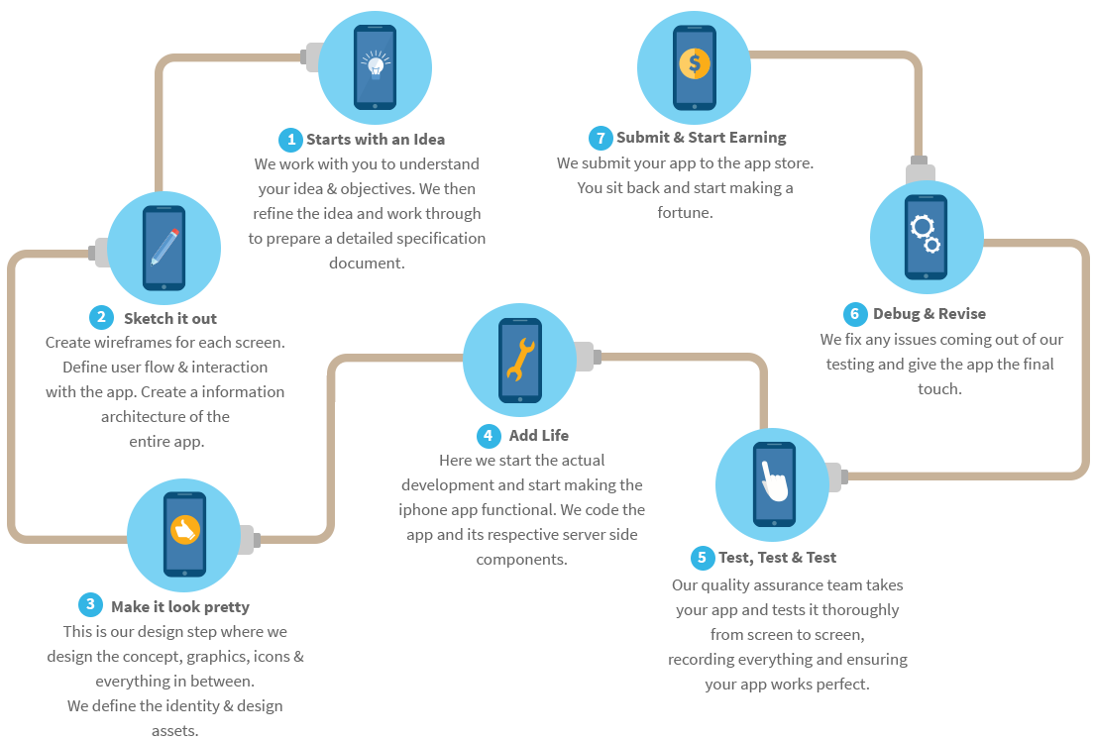
Overview:
Idea first
Design toolkit
Building the Application
Partners API Overview
The Repos and Access
The Challenge
Prizes

Slide 3
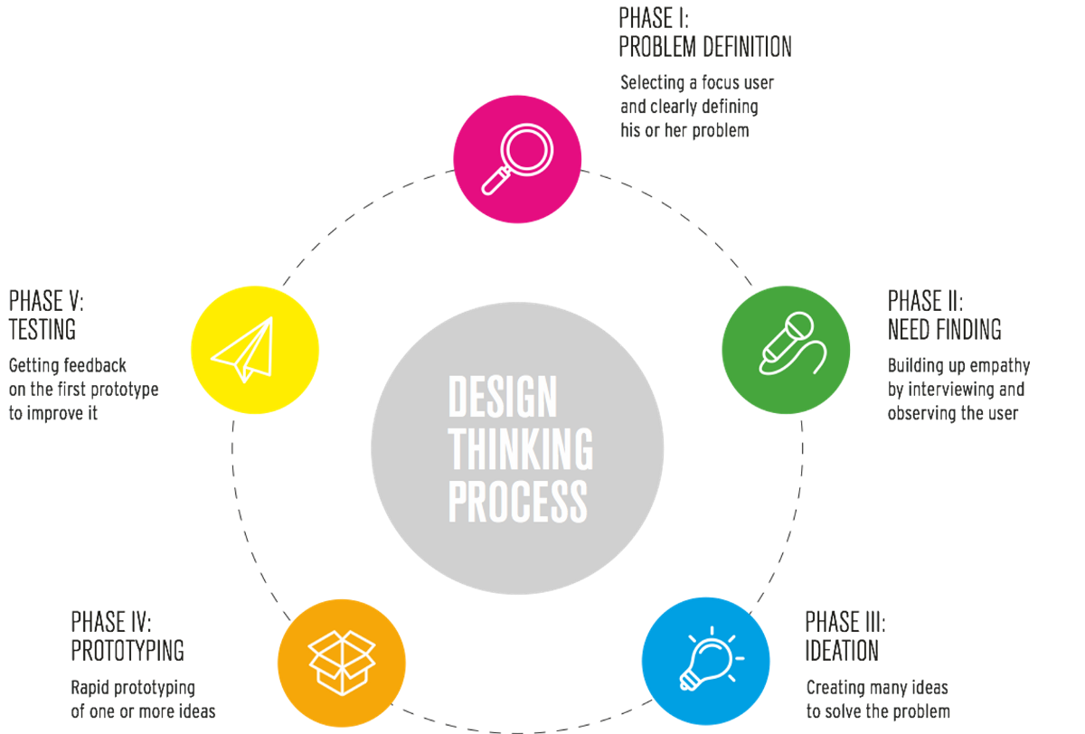
How to design with the customer in mind:

Slide 4


Phase I – Identify a Problem
Focus on identifying a problem, think back to past traveling experiences.
If the team already has an app idea, ask what problem it solves.
*Successful hackathon applications solve problems in a way that unique and efficient. Look around you, every product and service you use was created to solve a problem.

Slide 5


Phase II – Validate the need
Defining a Persona can help discover the need.
This validation will prove that a demand exists for your app.
Creating a Persona:
A Persona is a particular type of character that a person/group of people seem to have
*I would advise using yourself or someone like you as a persona so that it is relatable

Slide 6
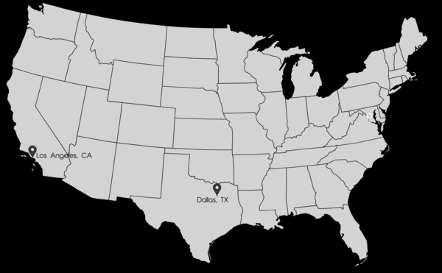
Phase II – Validate the need (CONT’D)
Example:
Jacob, 21 and a college student.
He is tasked with planning the travel for an upcoming spring break trip. He needs to know the flights from Los Angeles to Dallas on a specific day.

Slide 7
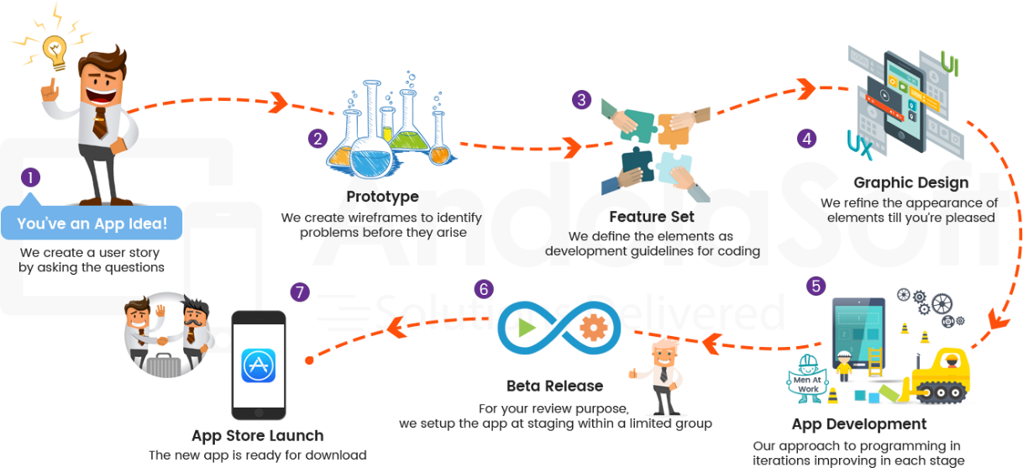
Phase III – Application Flow (The How)
Define the flow and features.
You have an idea that customers will use, now how will they use it.
Document the features
Create sketches or wireframes
Include the flow of how the user will navigate the app.

Slide 8

Phase III – Application Flow (CONT’D)
List of possible features:
Login feature (splash page)
Home screen with menu
The menu will include the below options:
Logout, flight search, saved flights, book flights
Logout will return the user to the splash page
Fight search will open a search window
Saved flights will open a list of flights the user has saved
Book flights will link to an external site to book flights
Flight search will open a list of flights
Note: This list can be used as the base to build your requirements from.

Slide 9
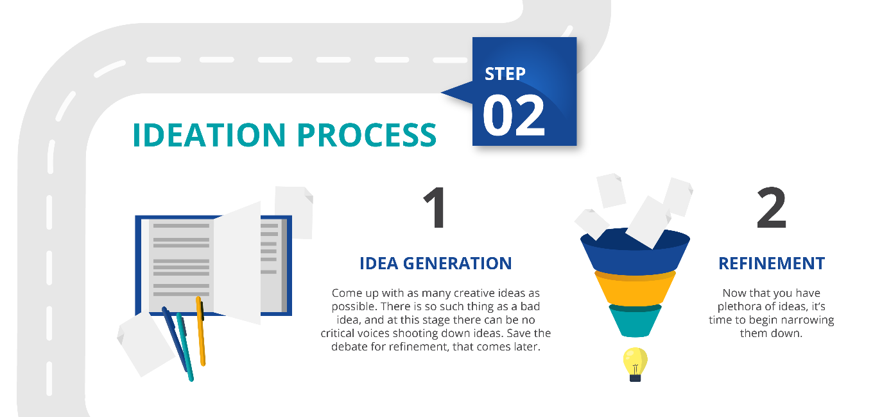
Phase IV – Refinement
Refine your feature set by remove non-core features. Review the flow and features document you prepared. Look for features that you can remove.
*Remember, the hack is only for 24hrs – that’s only enough time to build the core features of the idea.

Slide 10
Phase IV – Refinement (CONT’D)
Based on the original problem we can refine the application to a core feature:
Login feature (splash page)
Home screen with menu
The menu will include the below options:
Logout, flight search, saved flights, book flights
Logout will return the user to the splash page
Fight search will open a search window
Saved flights will open a list of flights the user has saved
Book flights will link to an external site to book flights
Flight search will open a list of flights

Slide 11
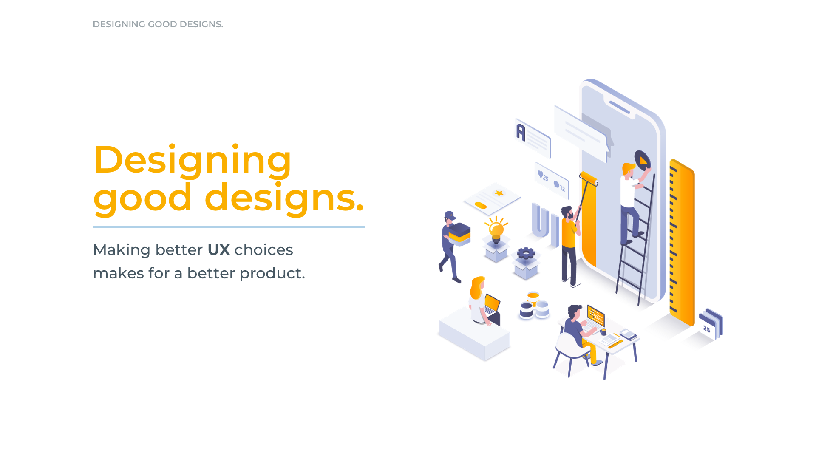

Slide 12
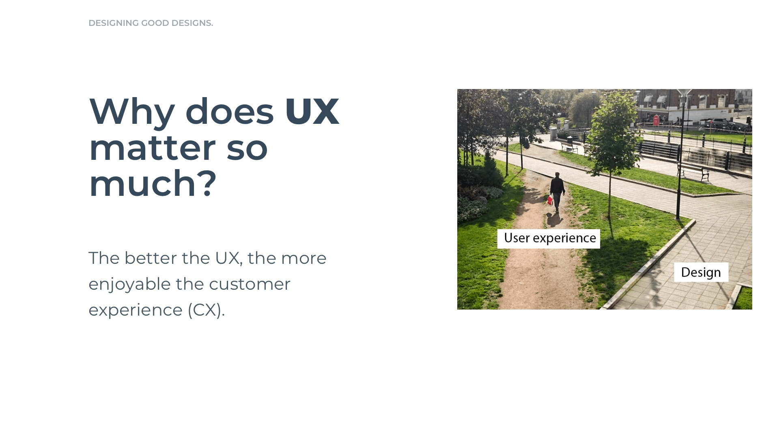

Slide 13
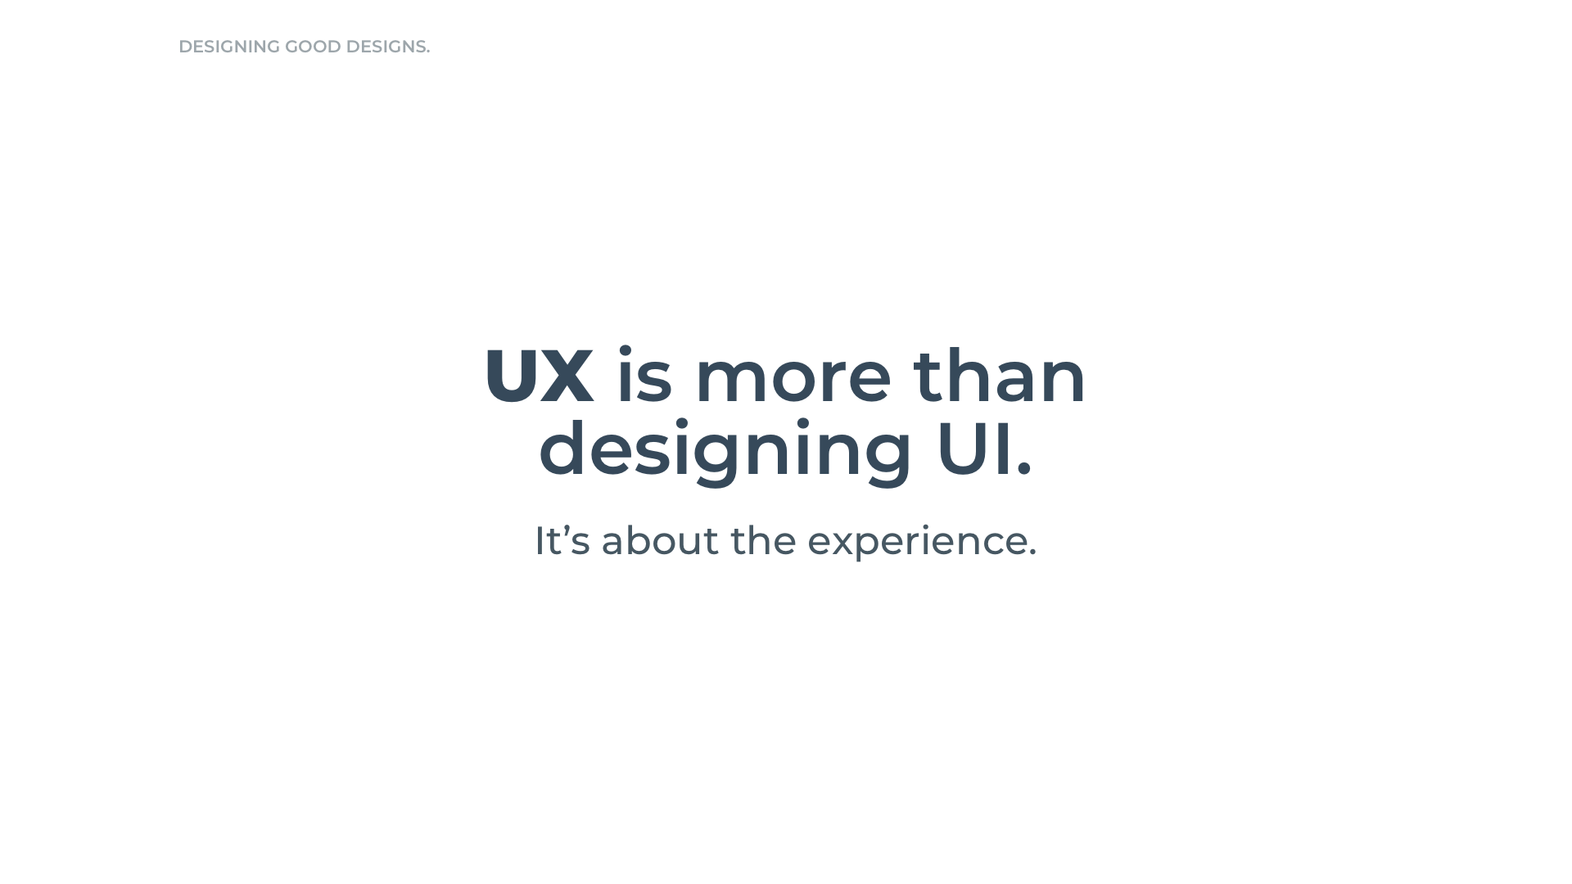

Slide 14
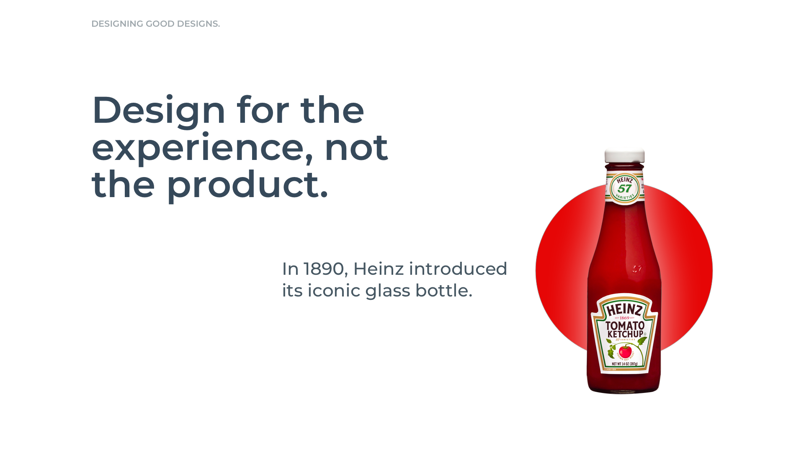

Slide 15
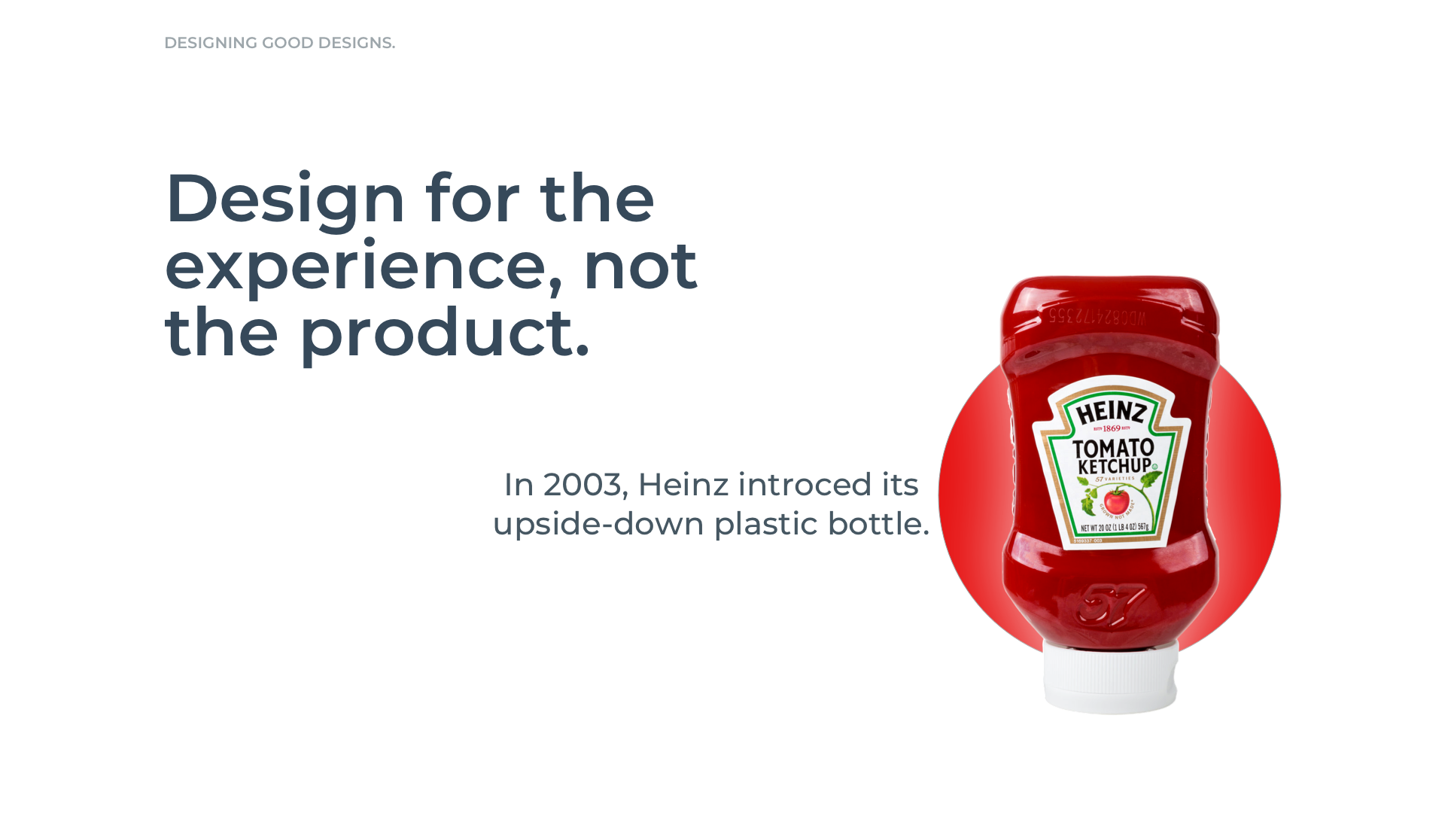

Slide 16
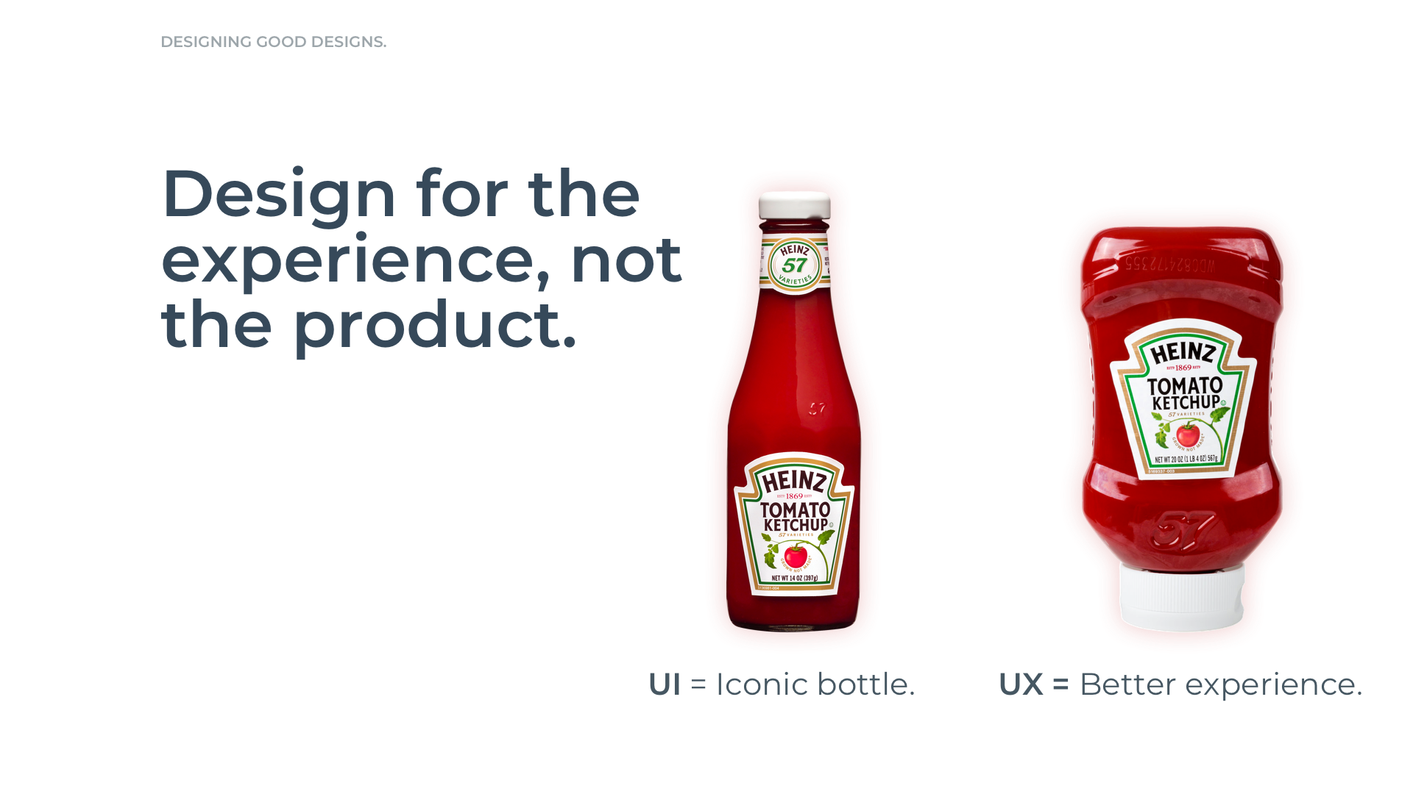

Slide 17
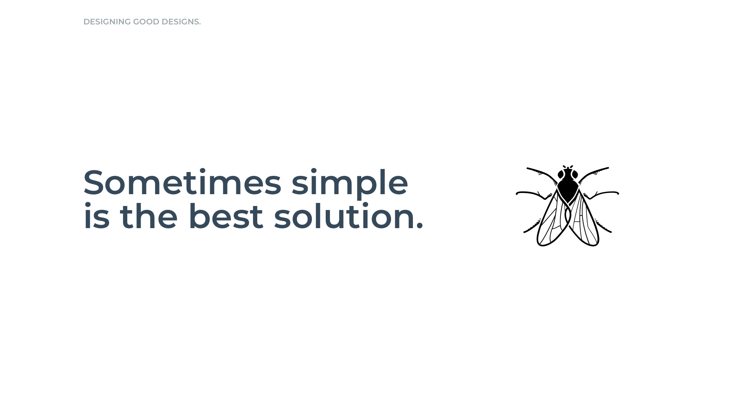

Slide 18
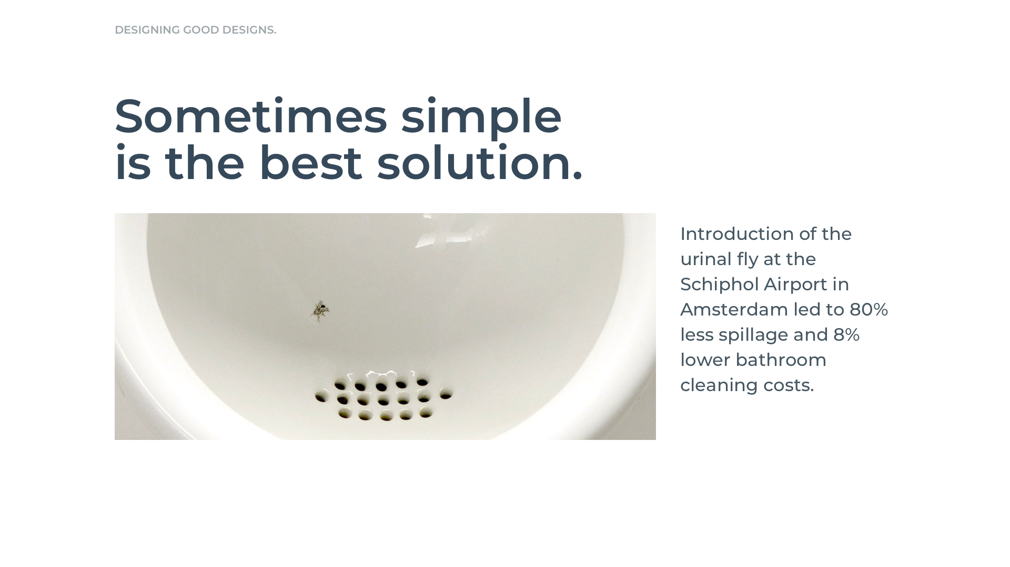

Slide 19
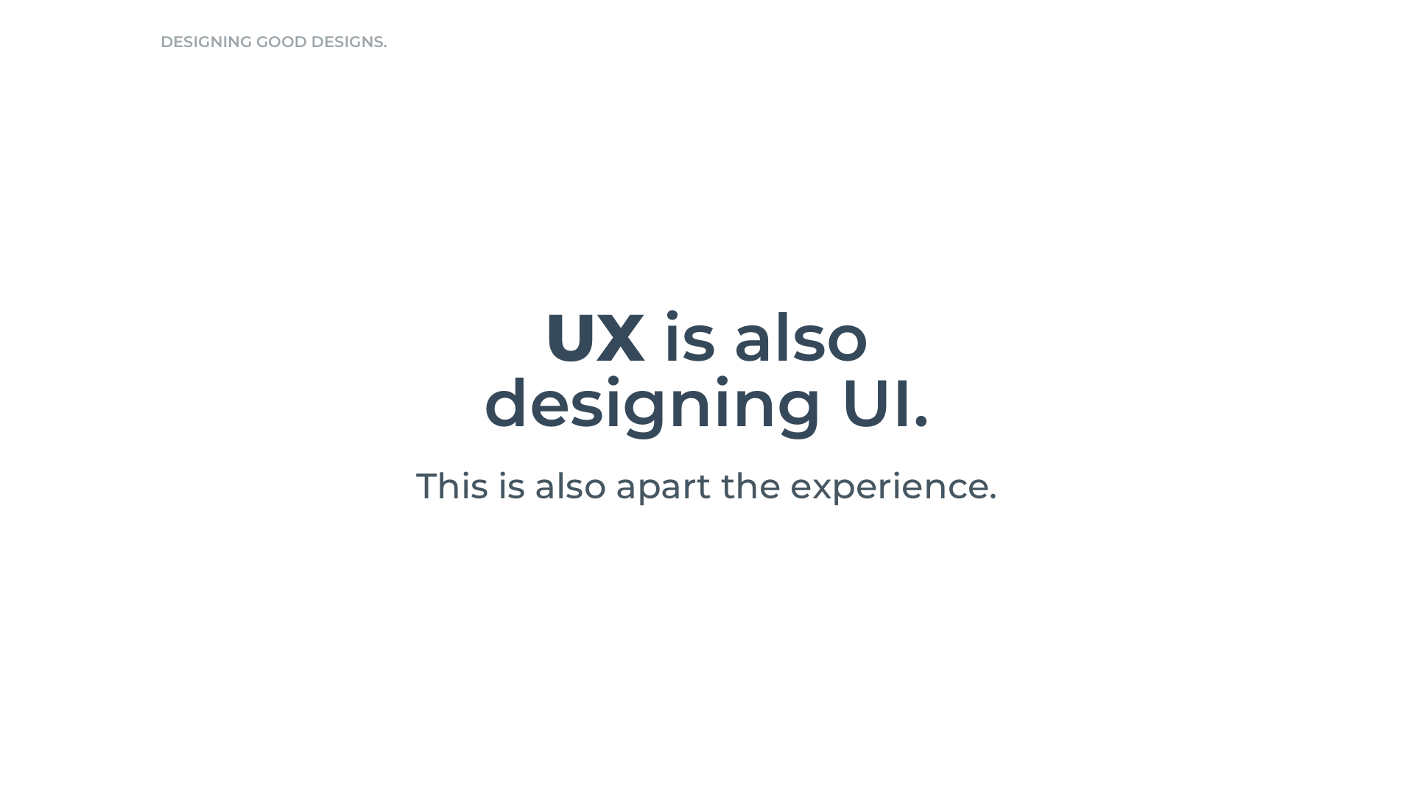

Slide 20
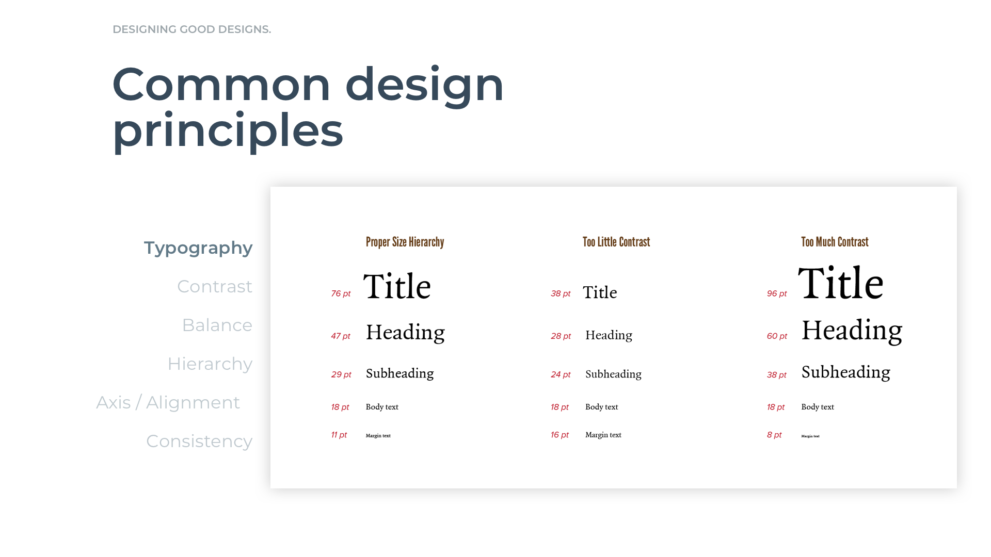

Slide 21
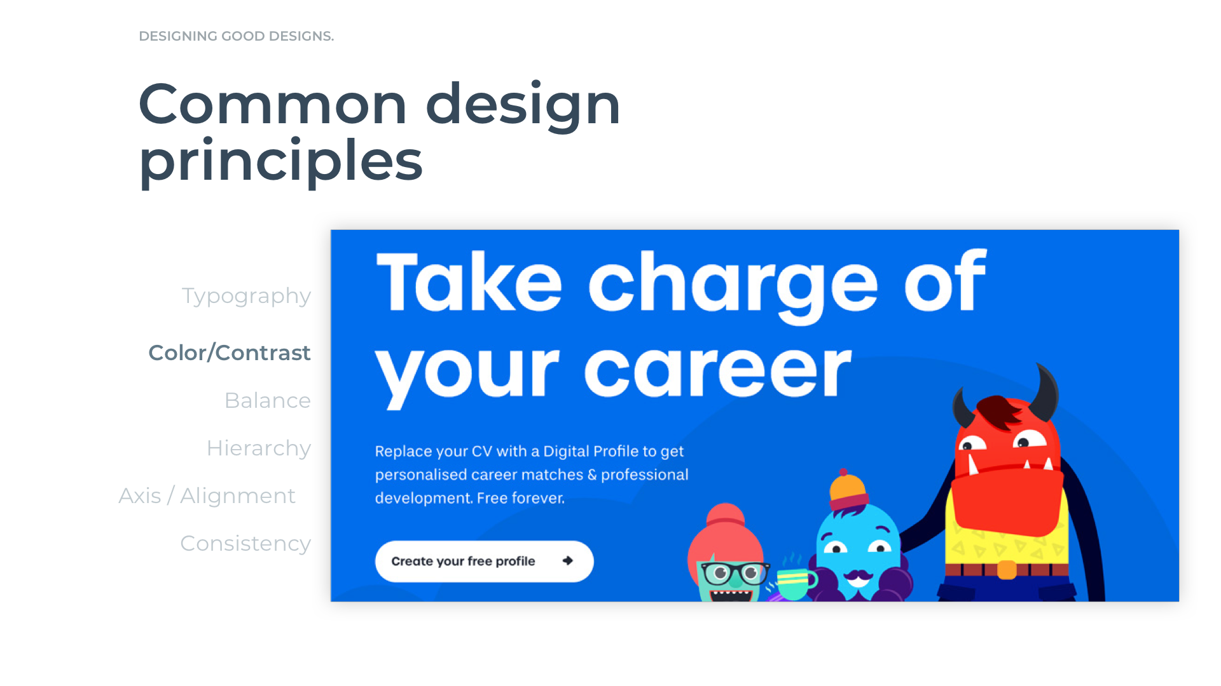

Slide 22
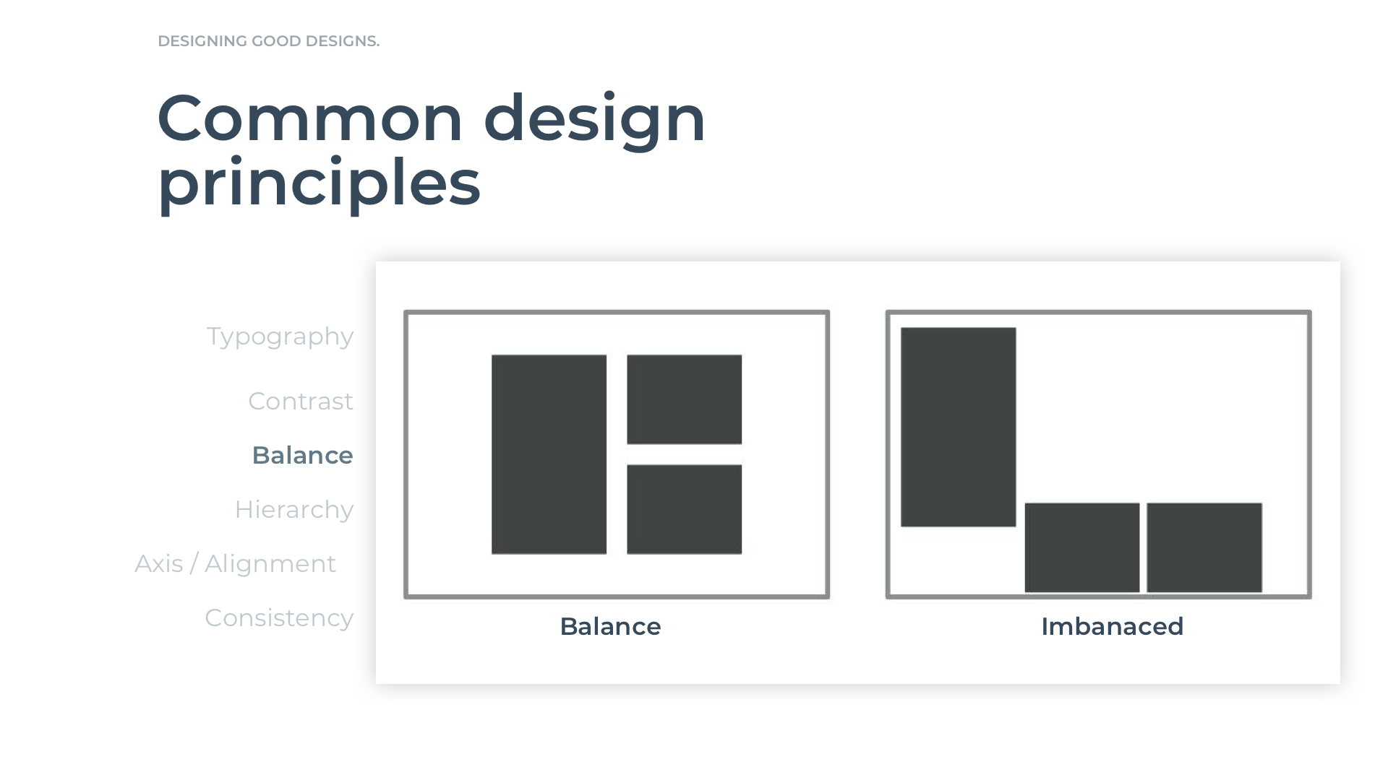

Slide 23
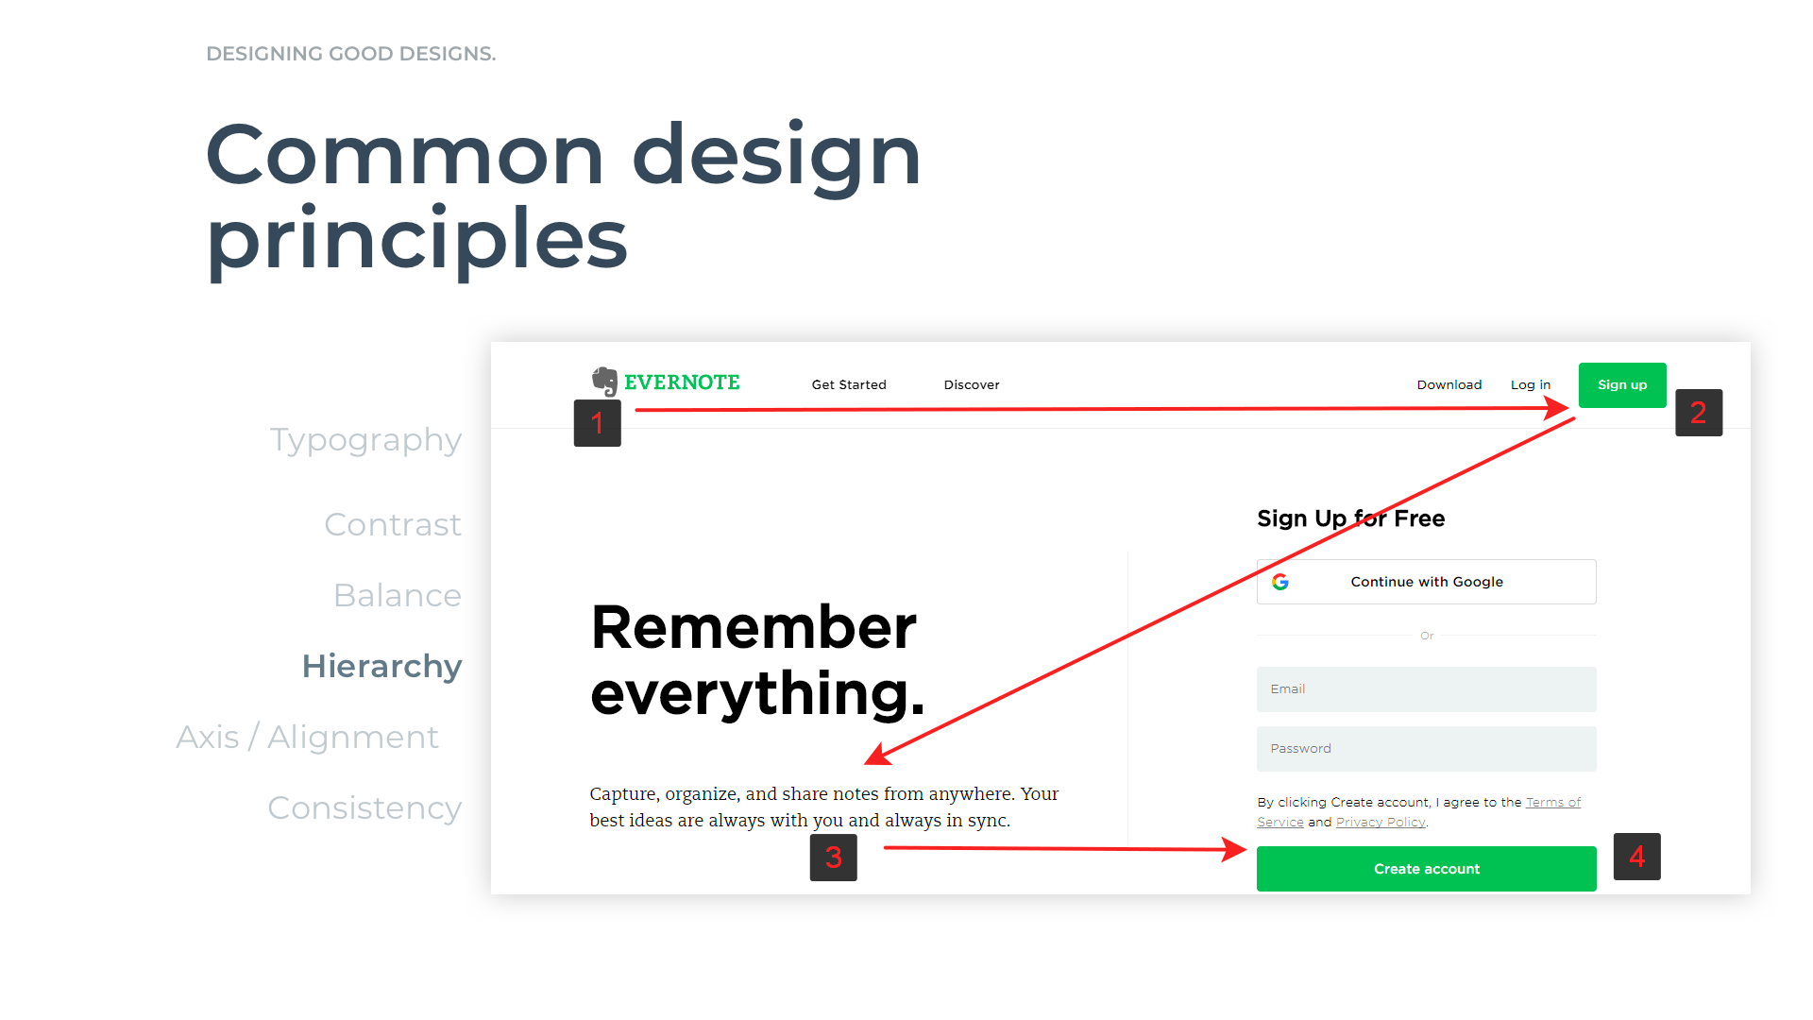

Slide 24
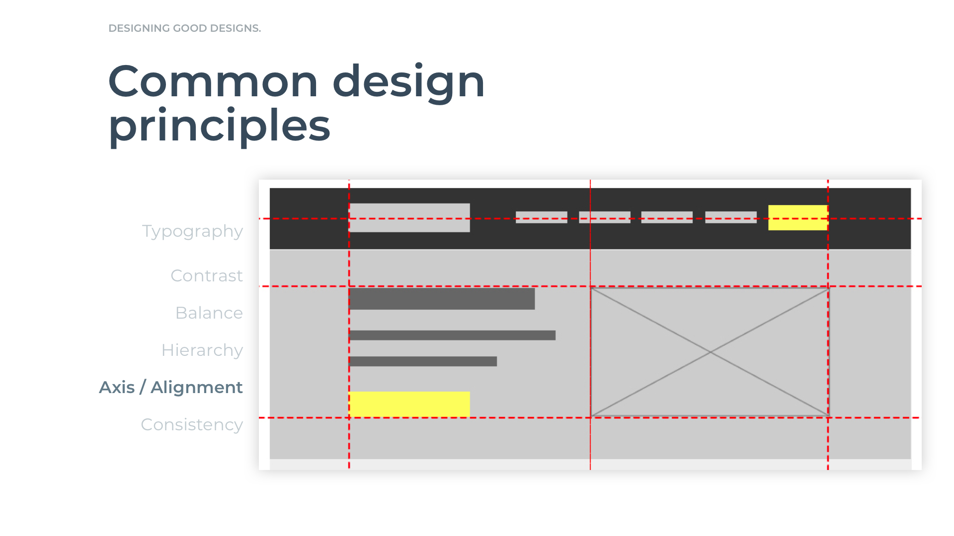

Slide 25
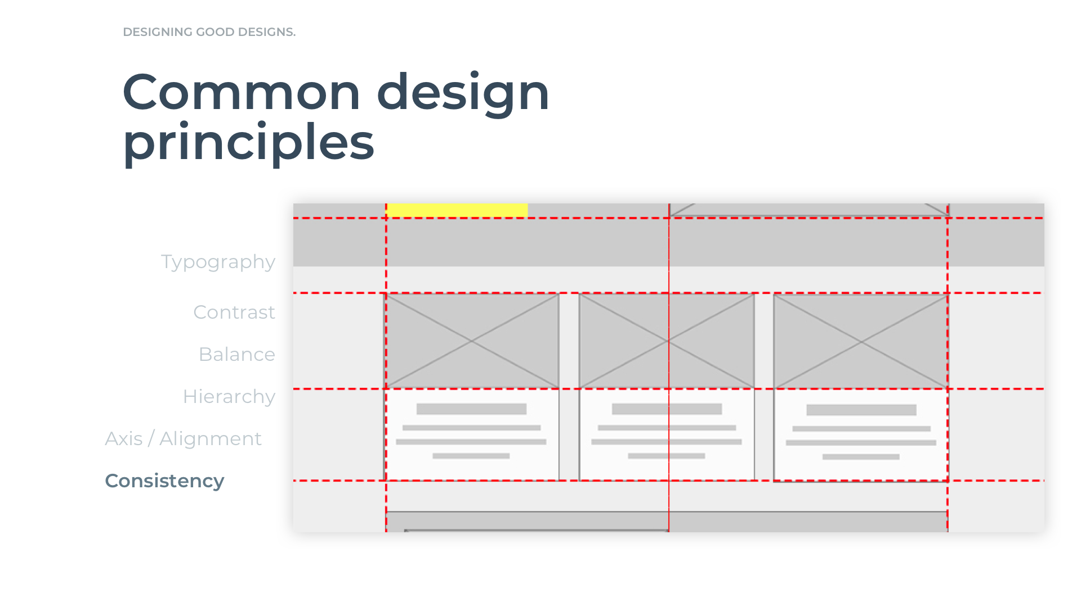

Slide 26
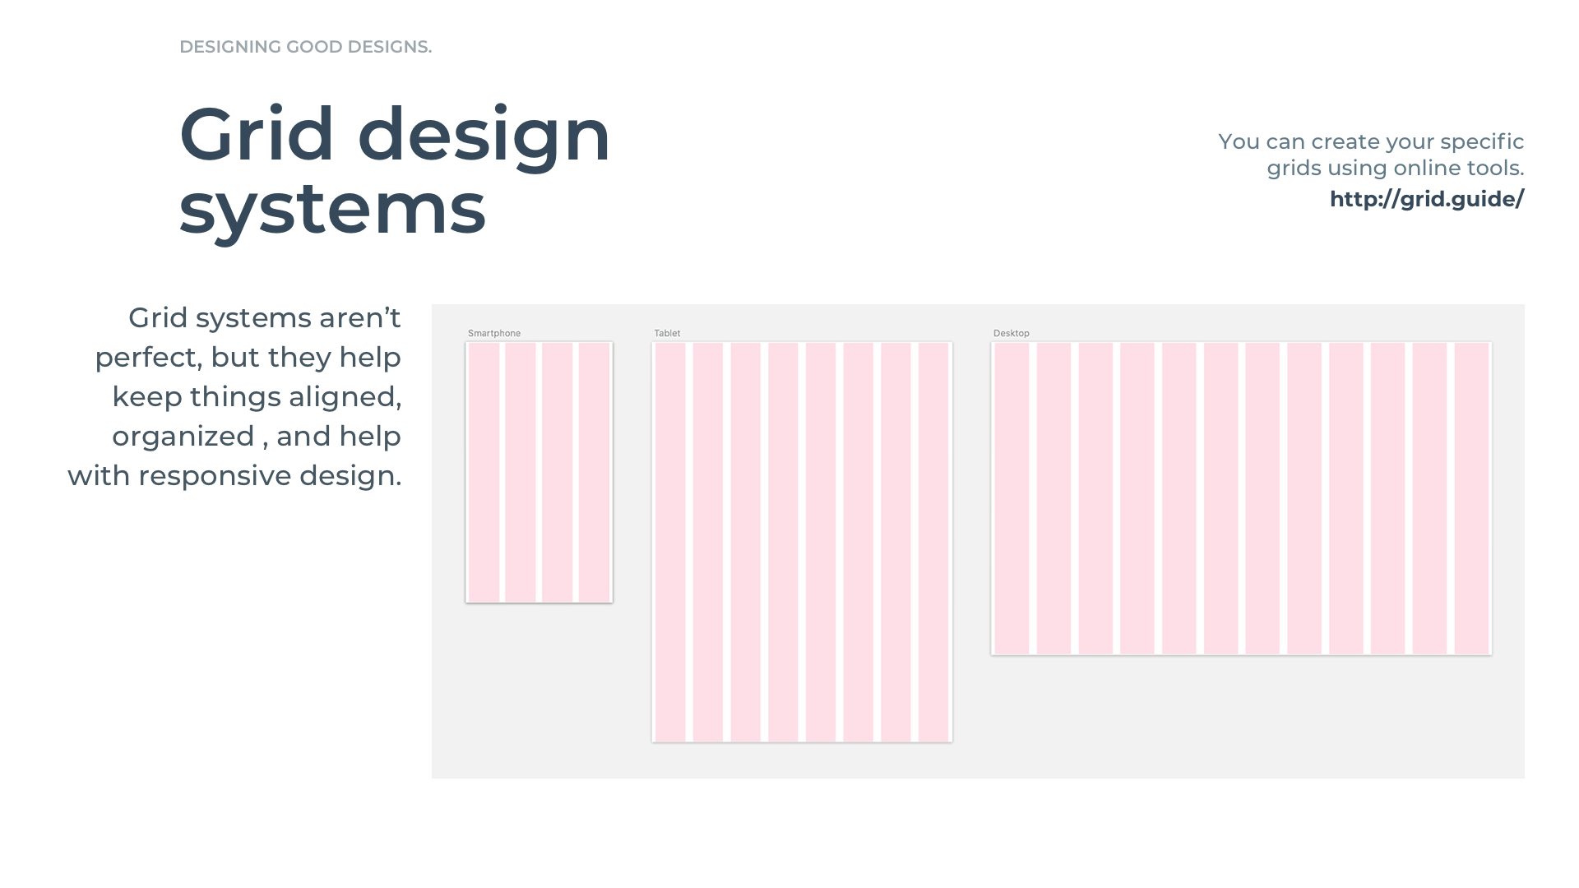

Slide 27
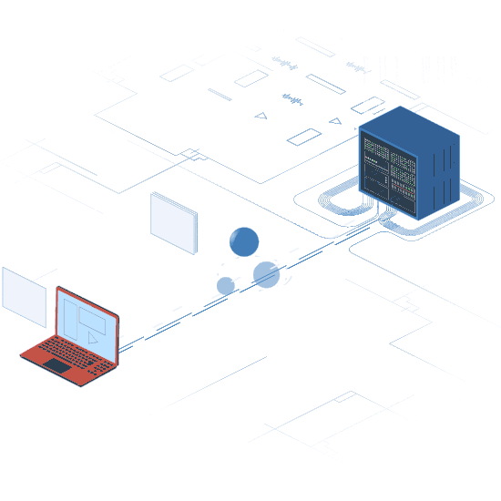
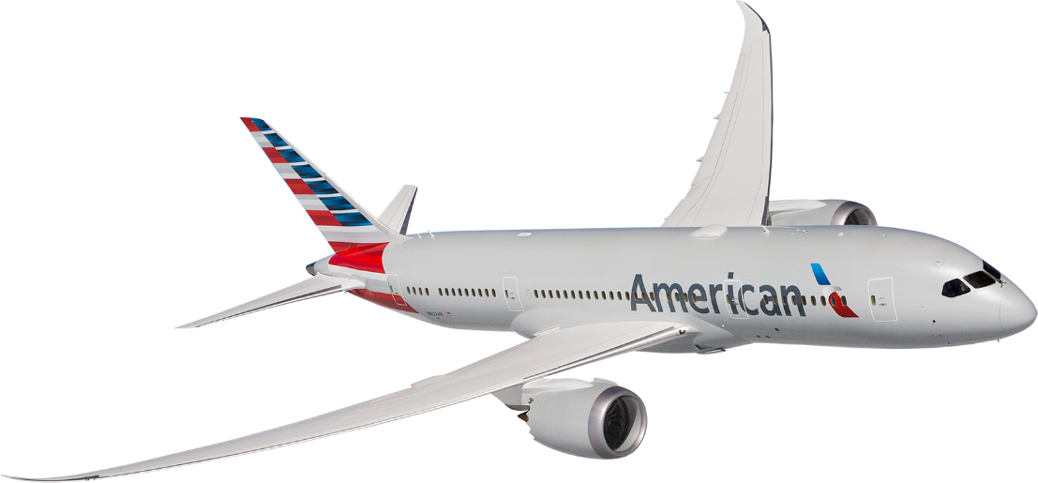
American Airlines API – Flight Engine
Mock flight data delivered simply and quickly without a database.

Slide 28
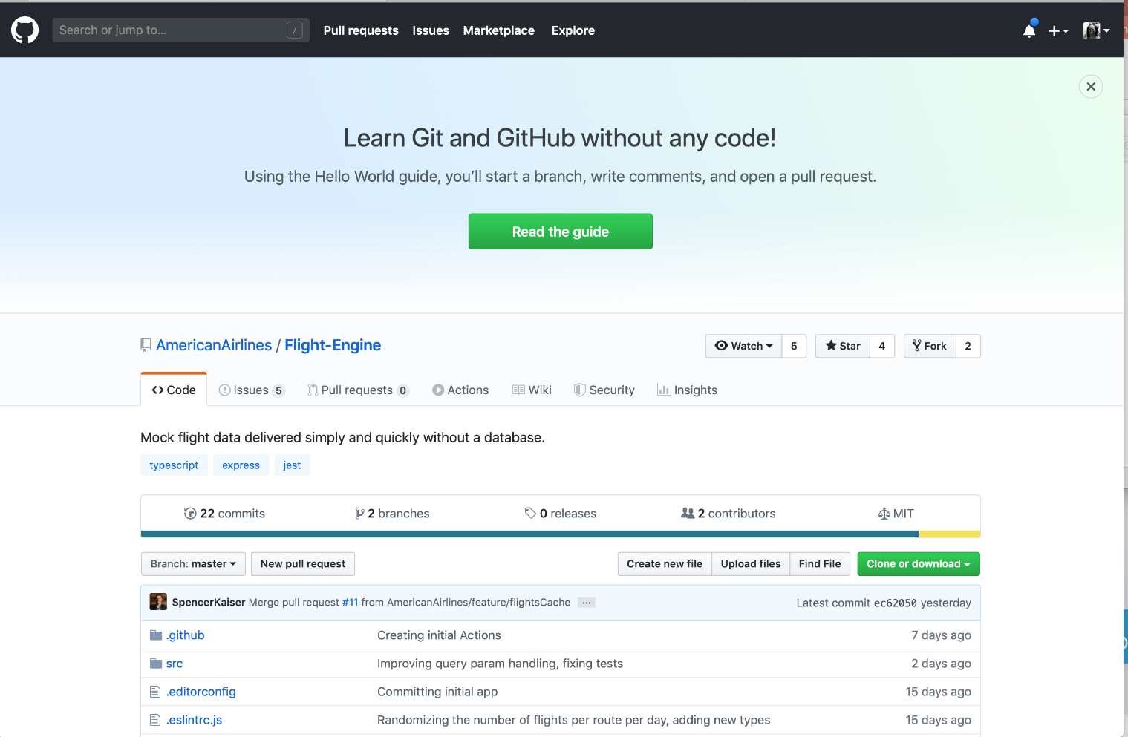
Getting Started: Flight Engine– Forking Repo

Slide 29
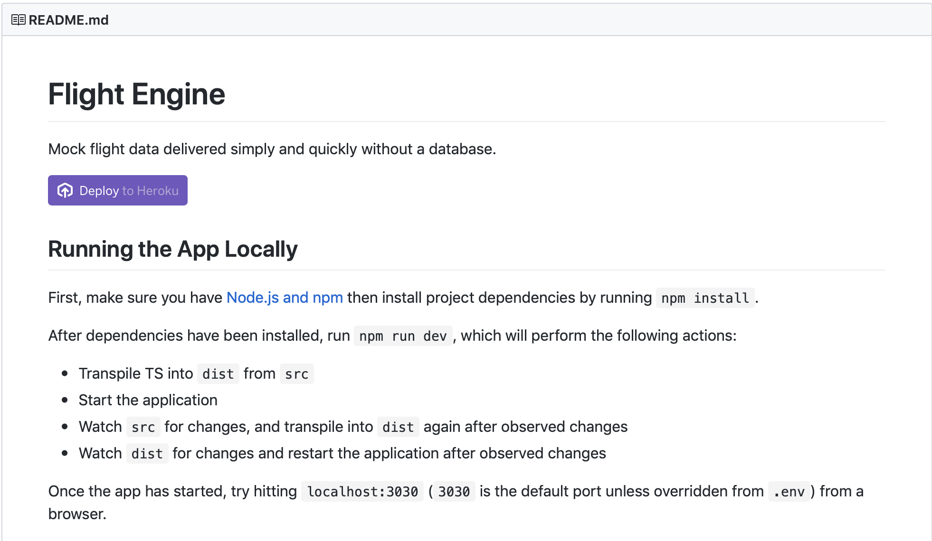
Flight Engine– Deploying
Request

Slide 30
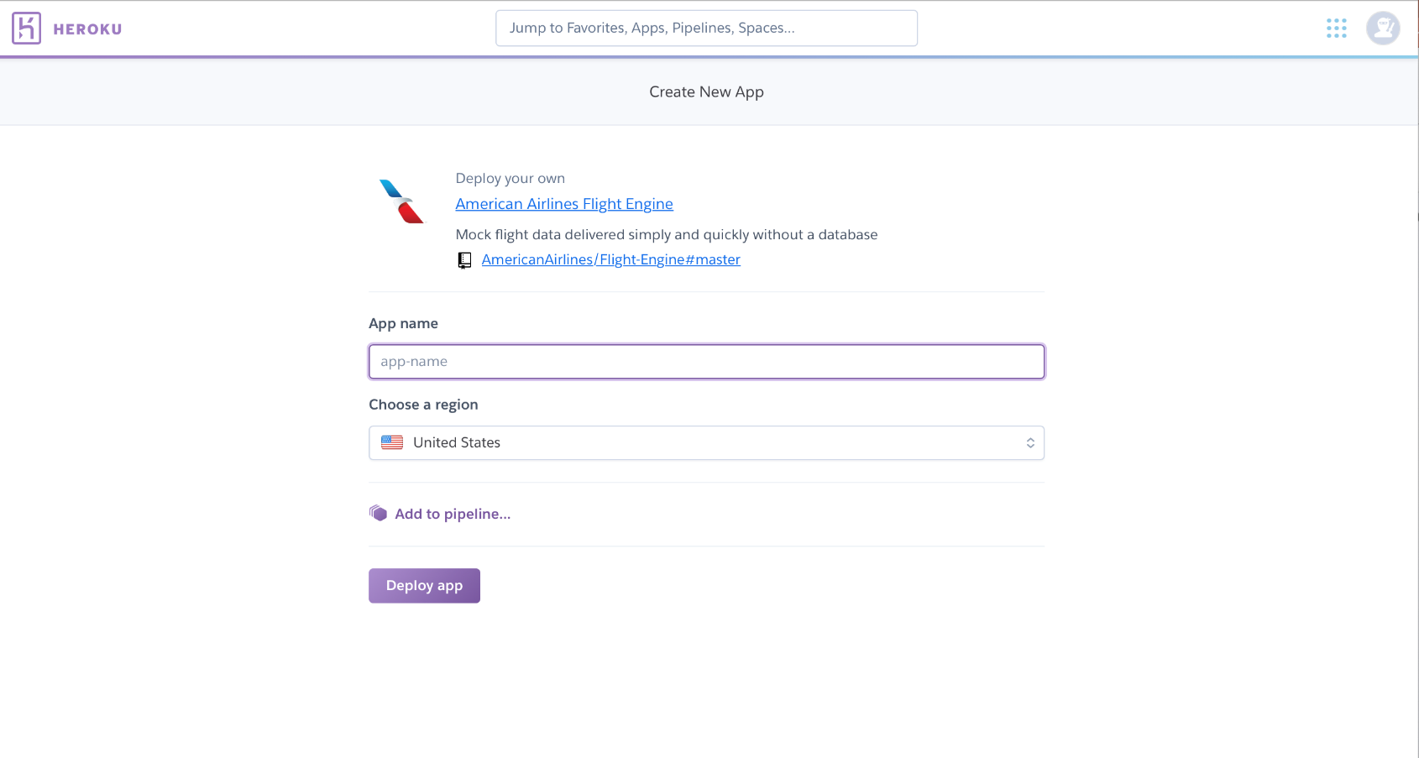
Flight Engine– Deploying

Slide 31
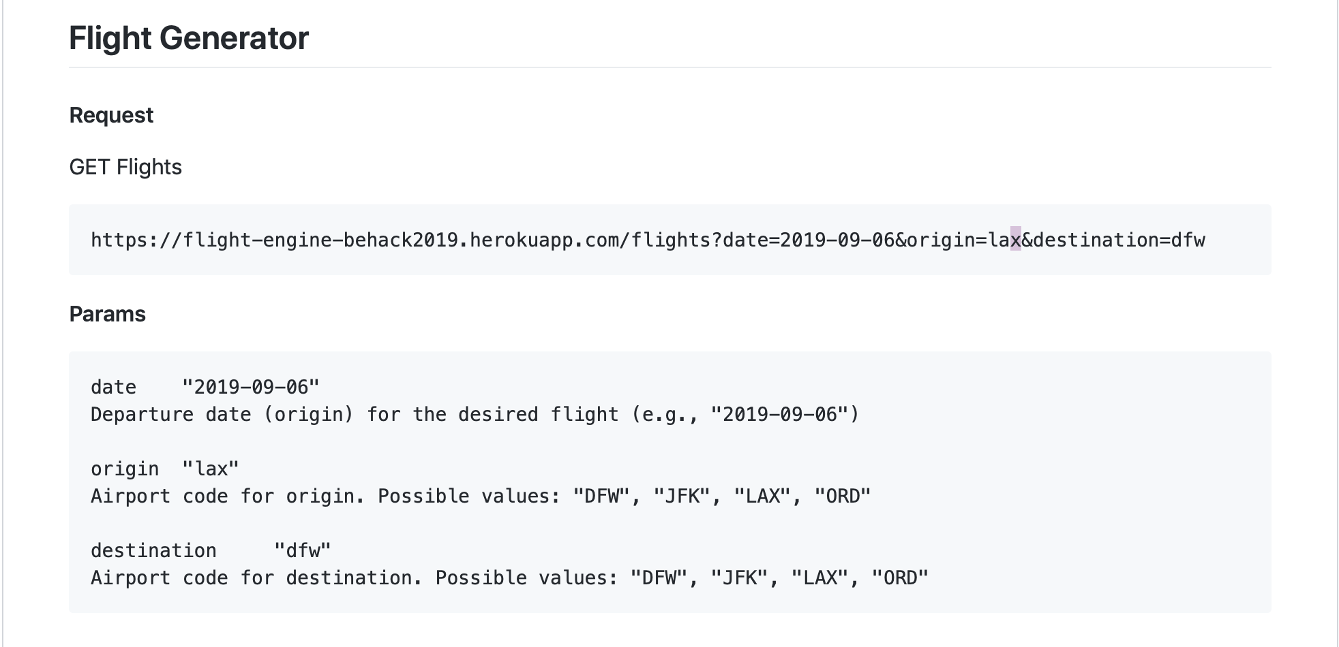
Flight Engine - Request
Using the Flight Generator is easy:

Slide 32
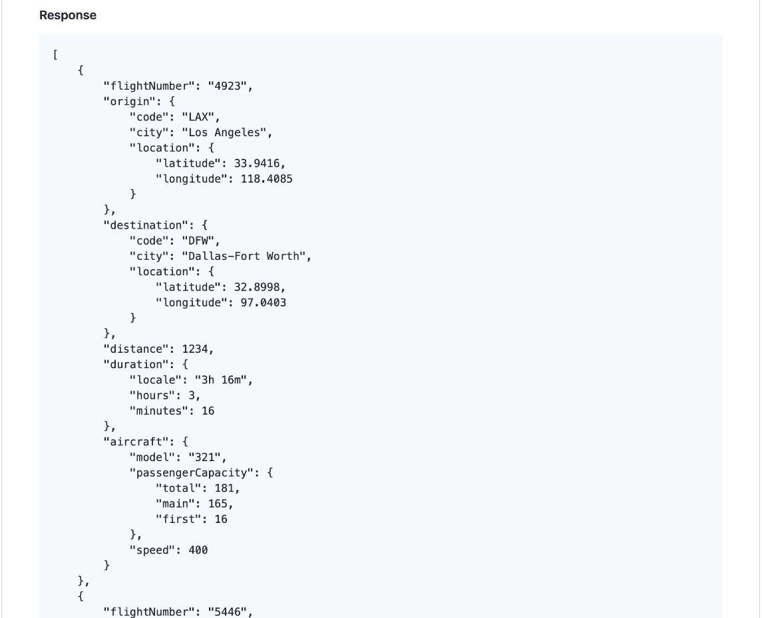
Flight Engine - Response
After a valid request is received, the Flight Generator will respond with a list of flights.
Some info returned is:
Flight number
City
Airport code

Slide 33
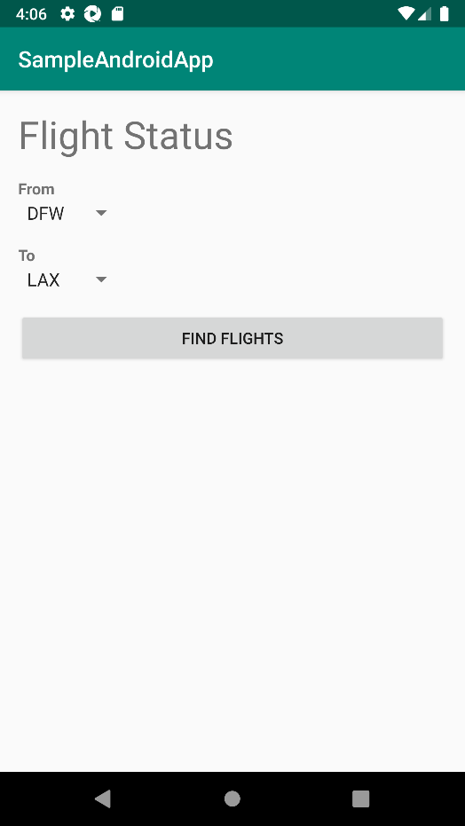
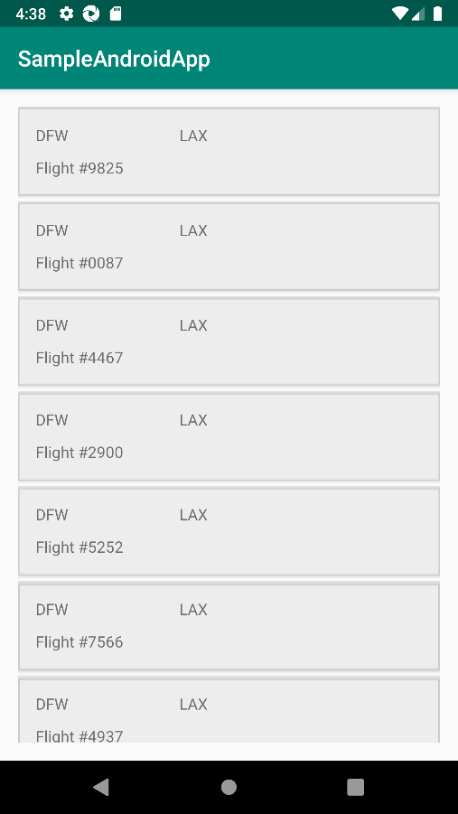
Application designs and flow (Android)
The design for Android:
Flight Search
Flight List

Slide 34
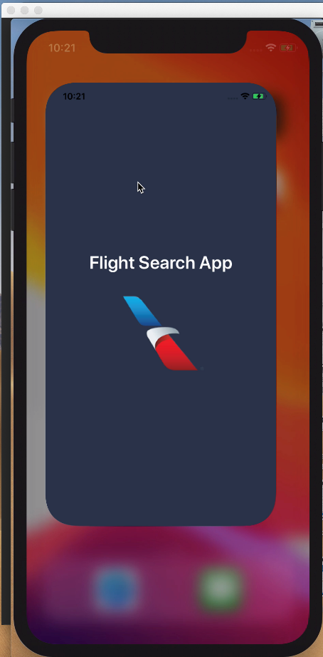
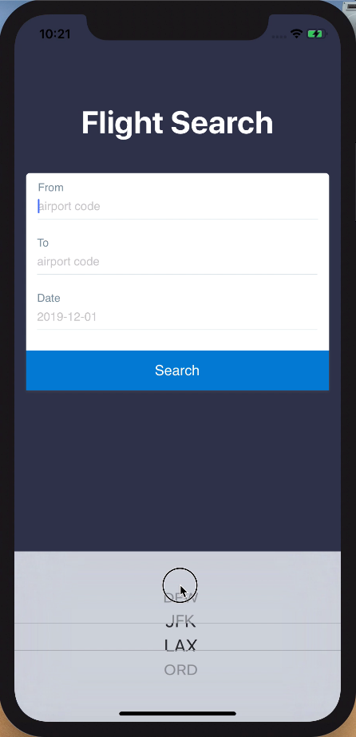
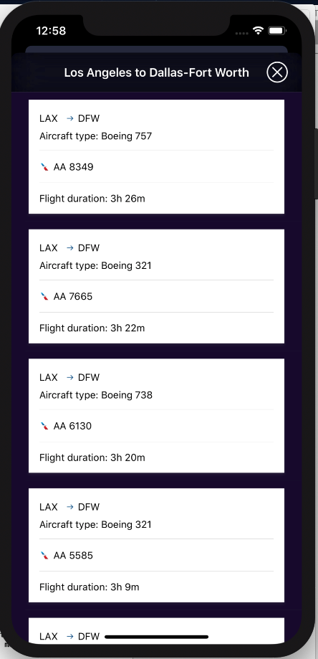
Application designs and flow (iOS)
The design for iOS:
Launch Screen
Flight Search
Flight List

Slide 35
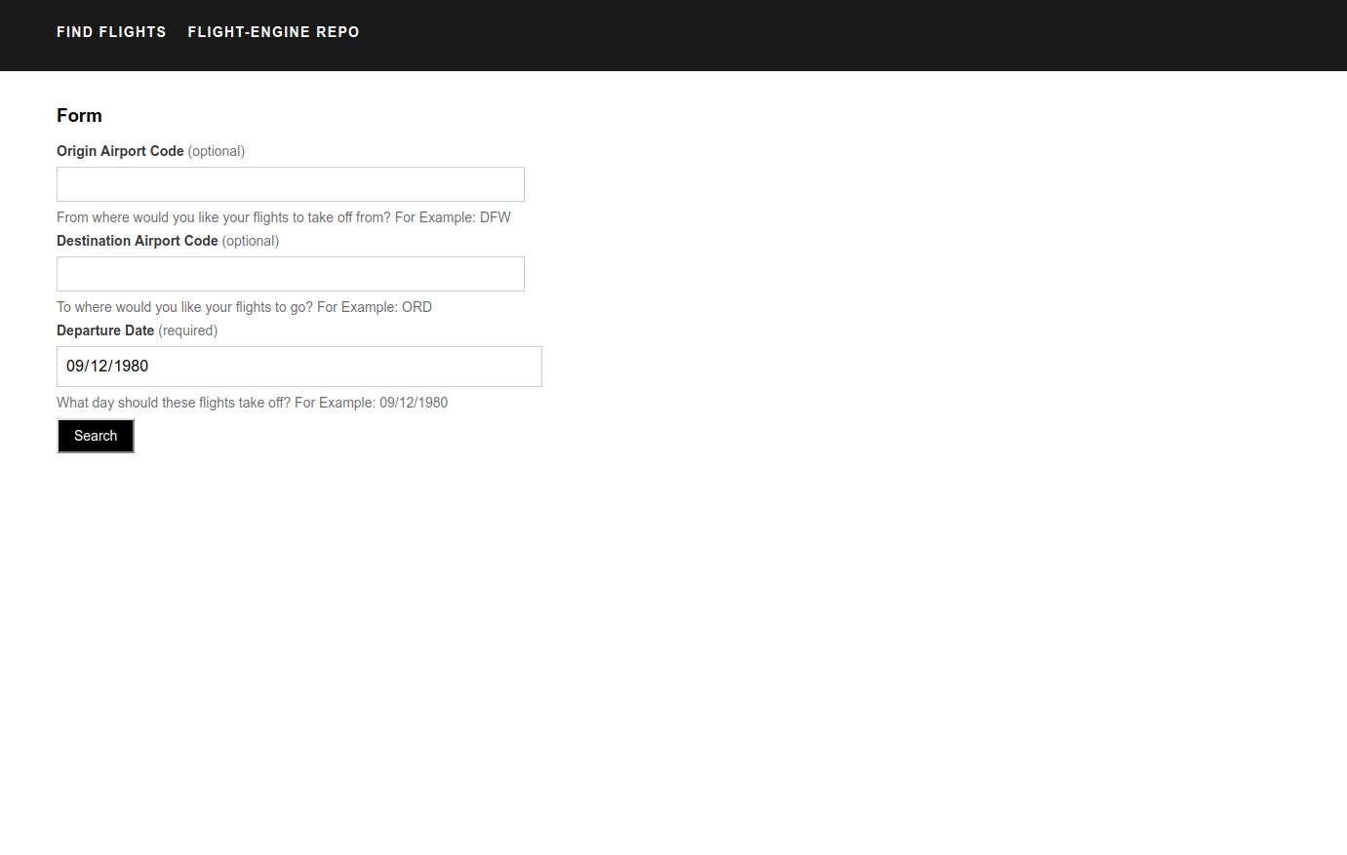
Application designs and flow (Web/Mobile Web)
The design for
Web/Mobile Web:
Flight Search

Slide 36
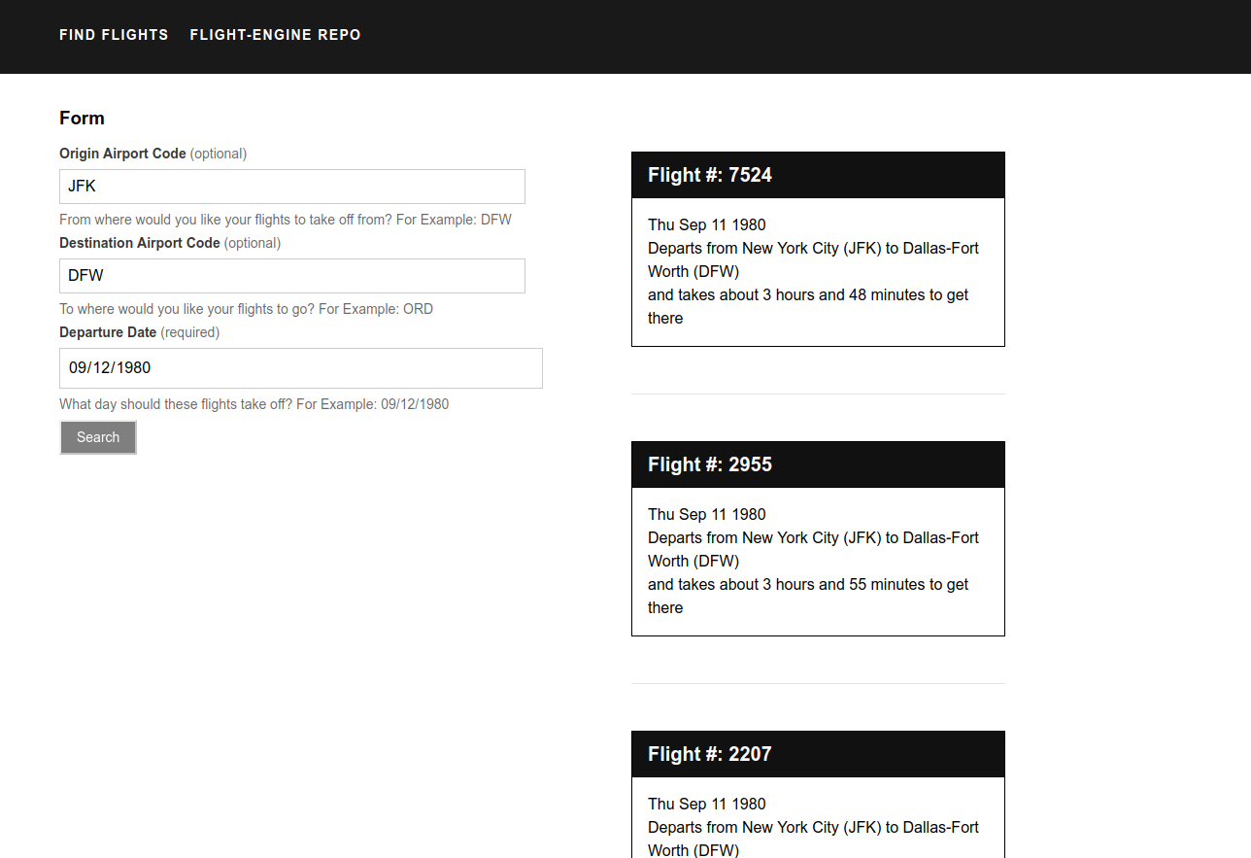
Application designs and flow (Web/Mobile Web)
The design for
Web/Mobile Web:
Flight Search
Flight List

Slide 37
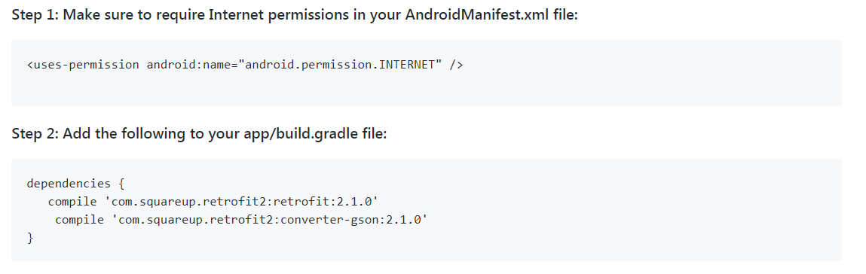
Frontend Android – making network requests

Slide 38
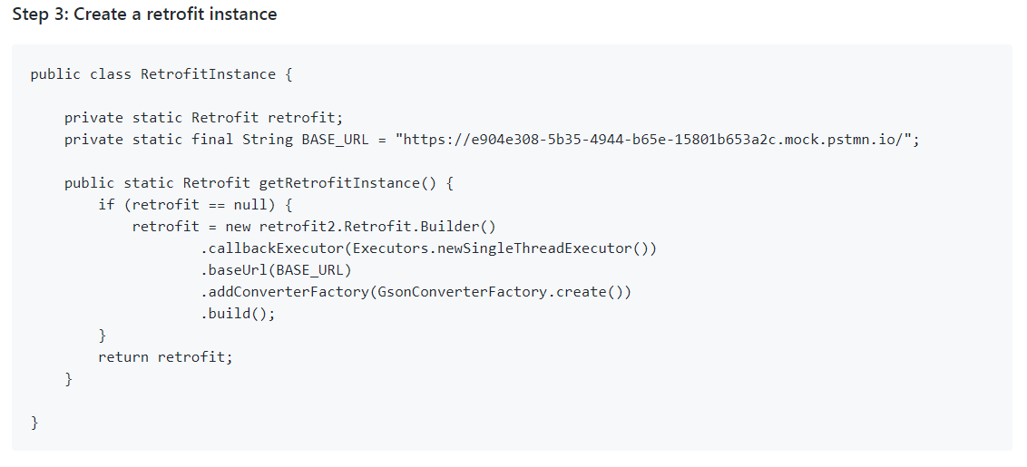
Frontend Android – making network requests (CONT’D)

Slide 39
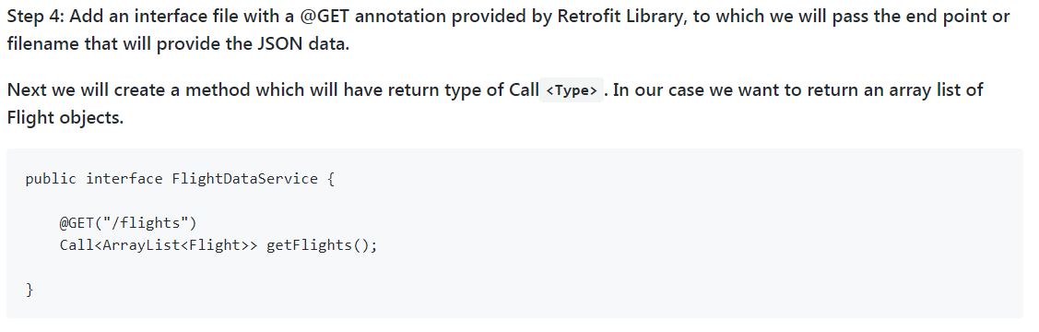
Frontend Android – making network requests (CONT’D)

Slide 40
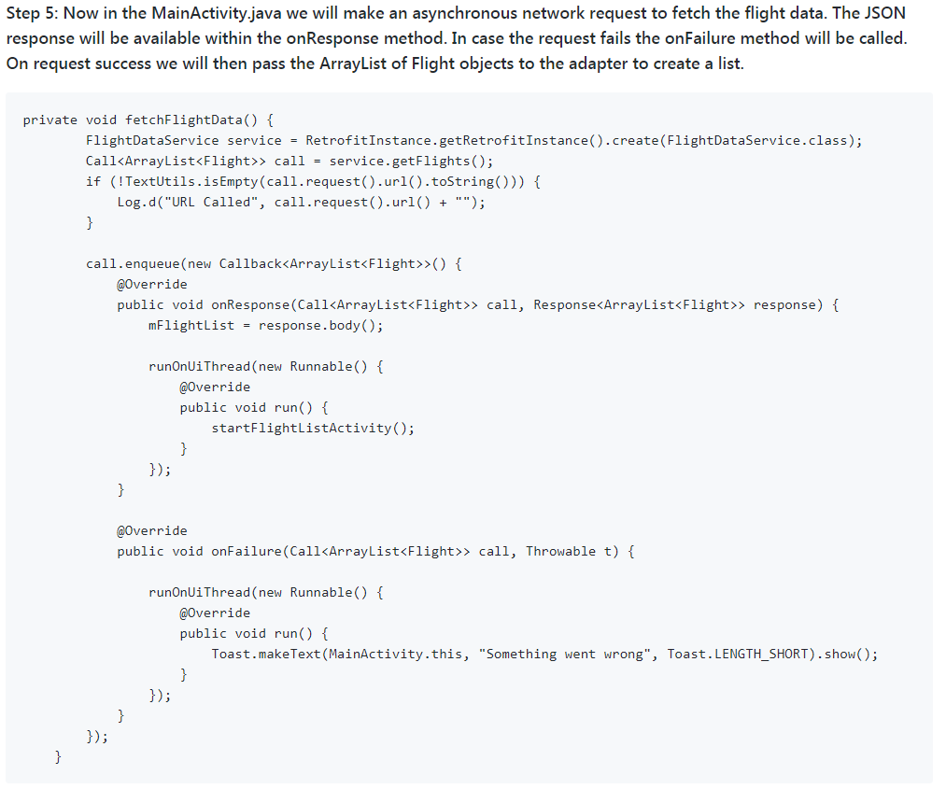
Frontend Android – making network requests (CONT’D)

Slide 41
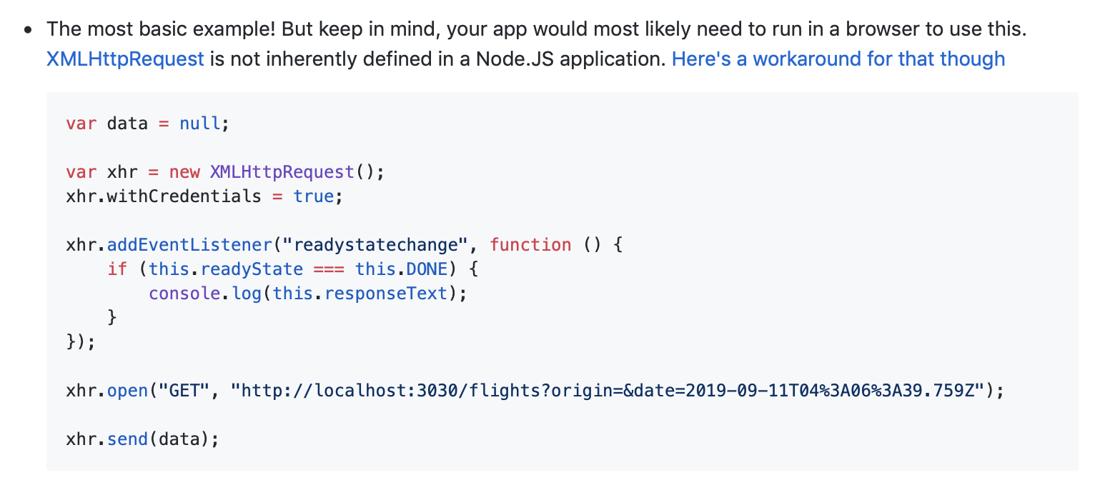
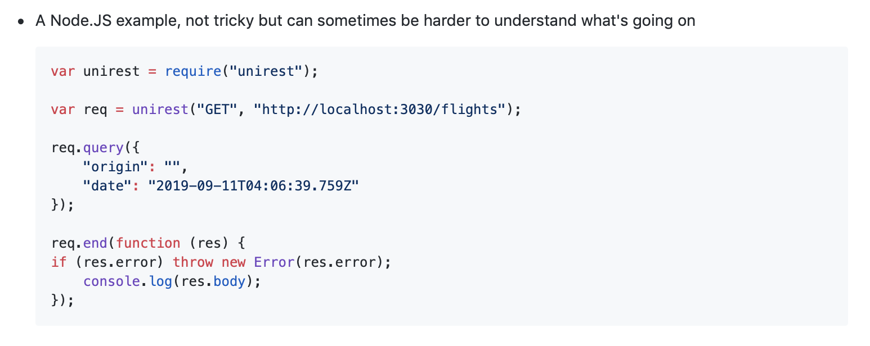
Frontend Web/Mobile Web – making network requests

Slide 42
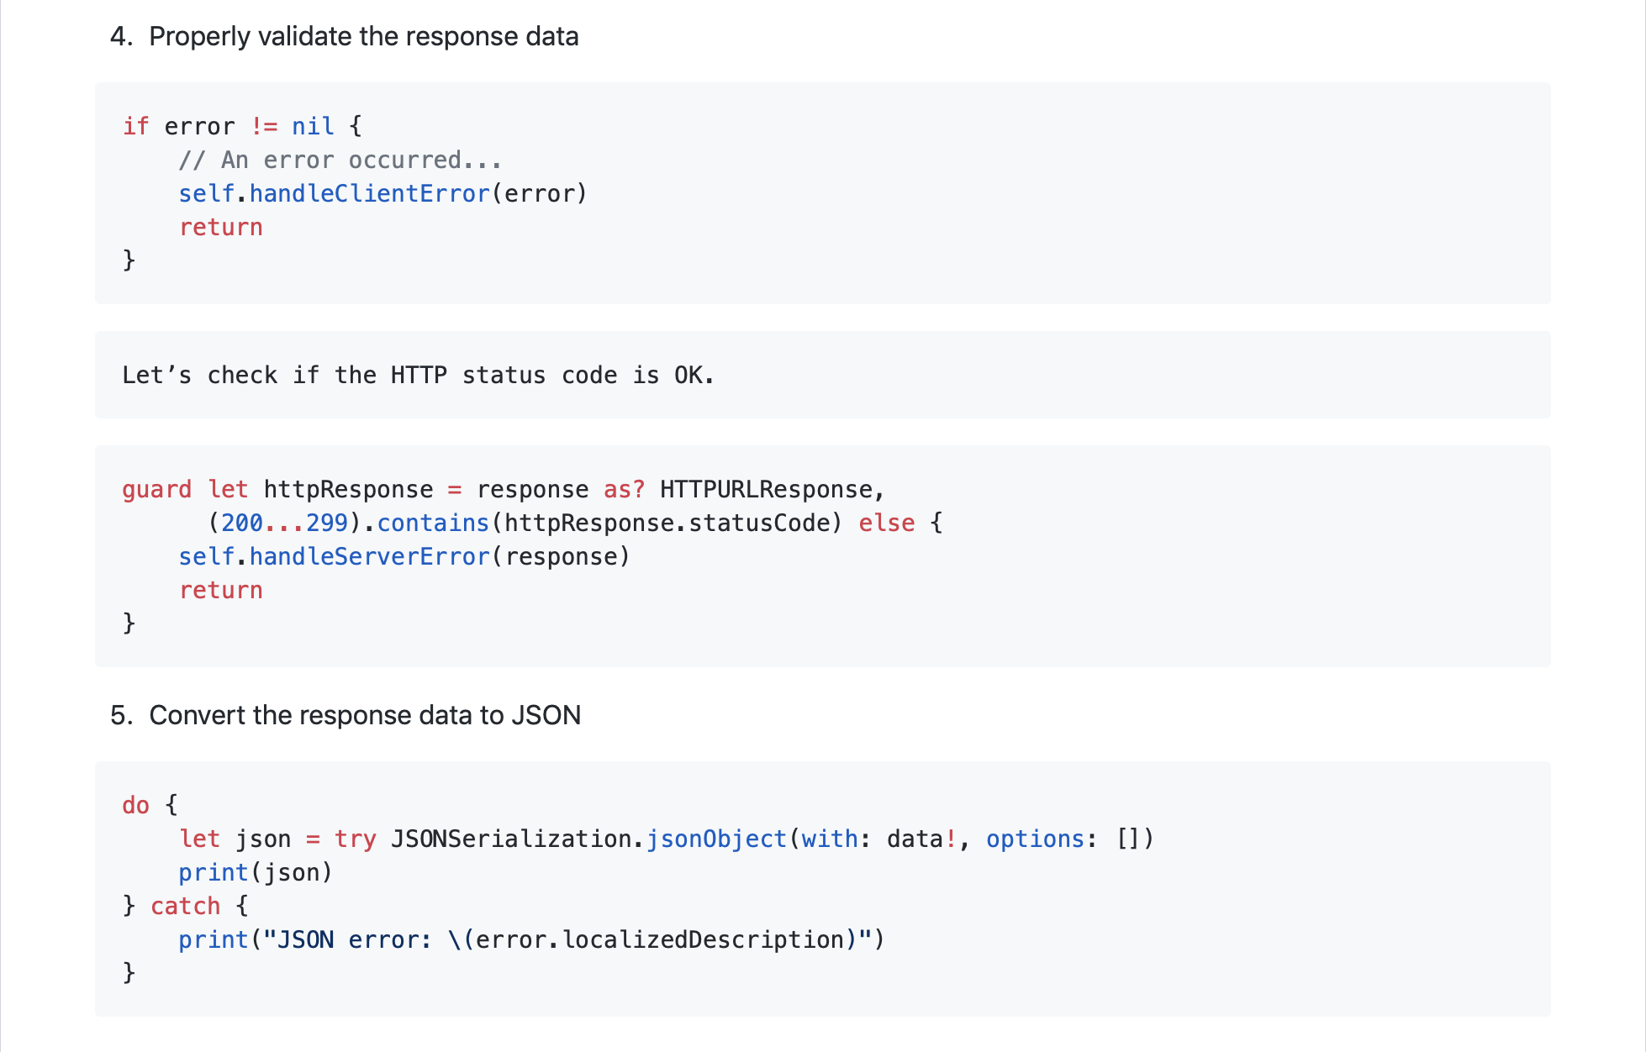
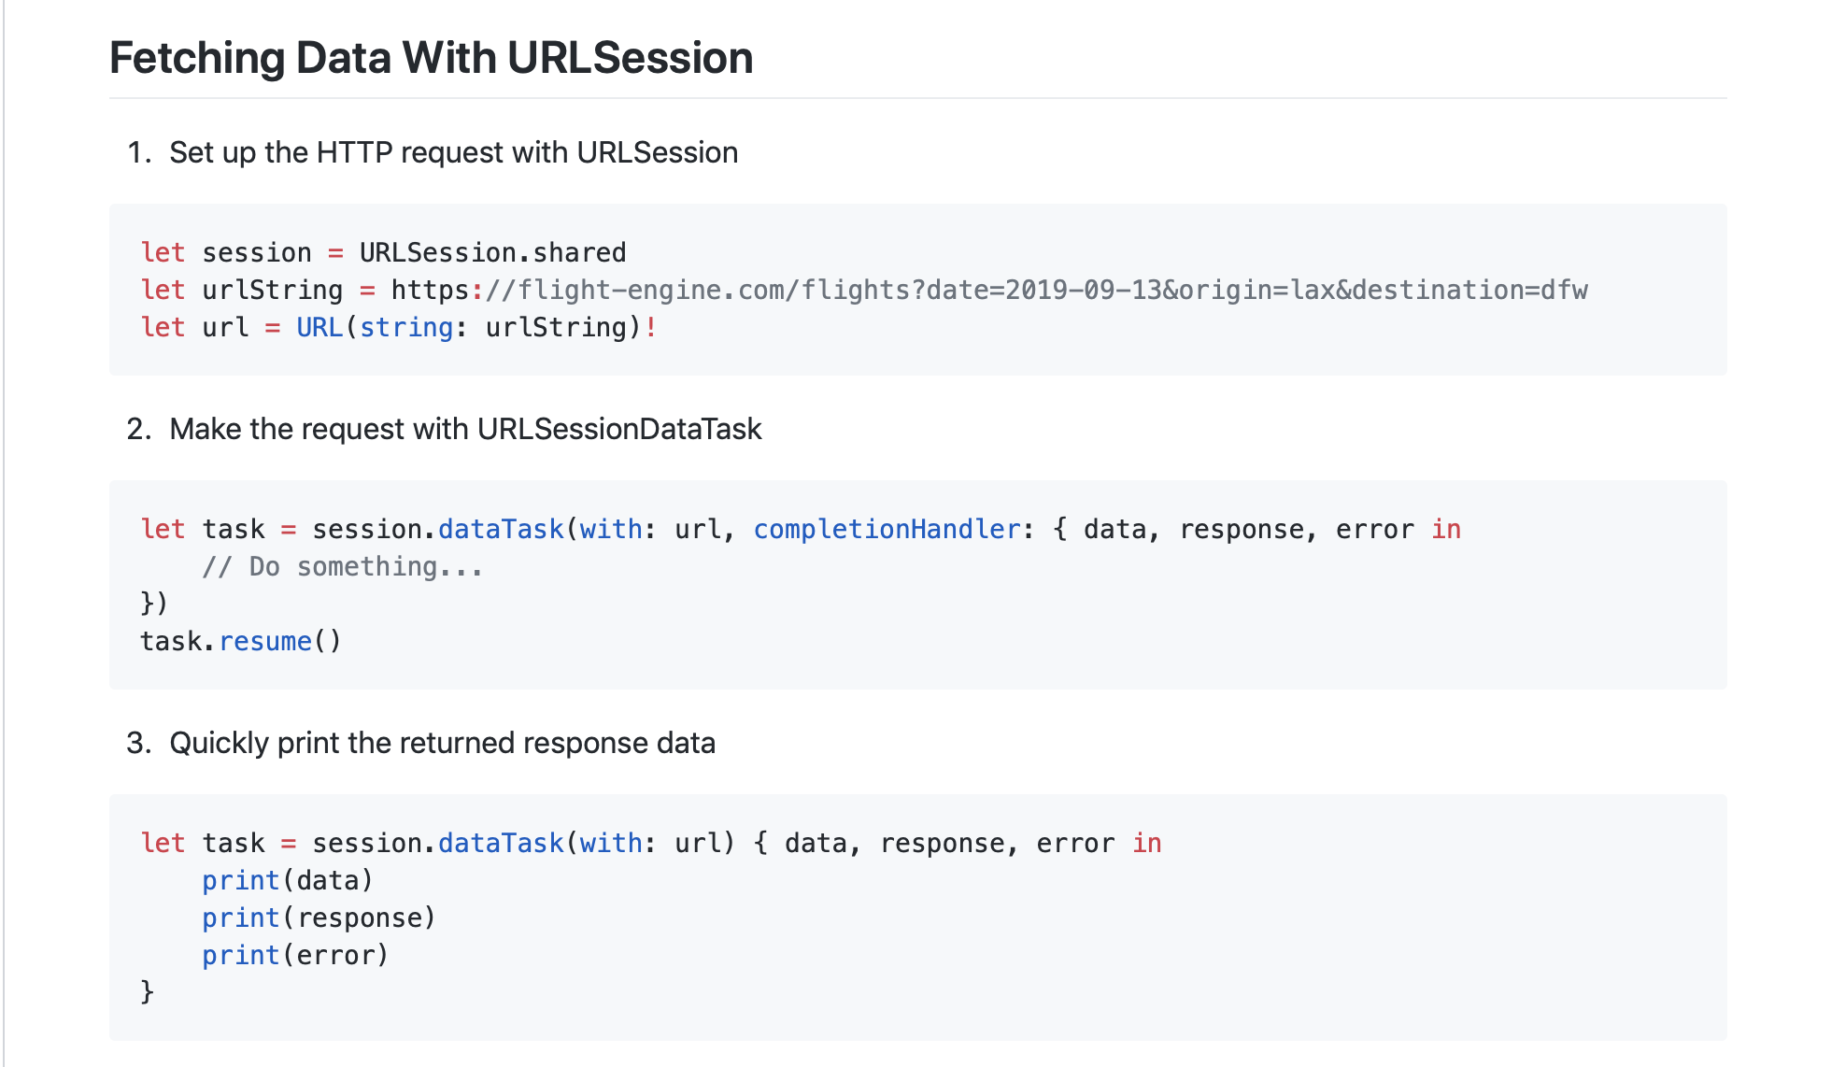
Frontend iOS – making network requests

Slide 43
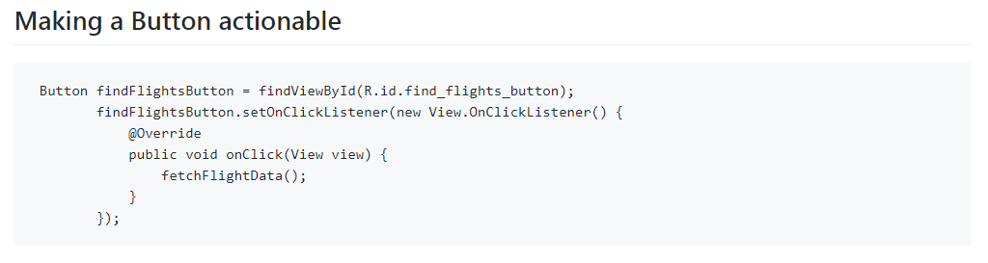
Frontend – Actionable buttons (Android)

Slide 44
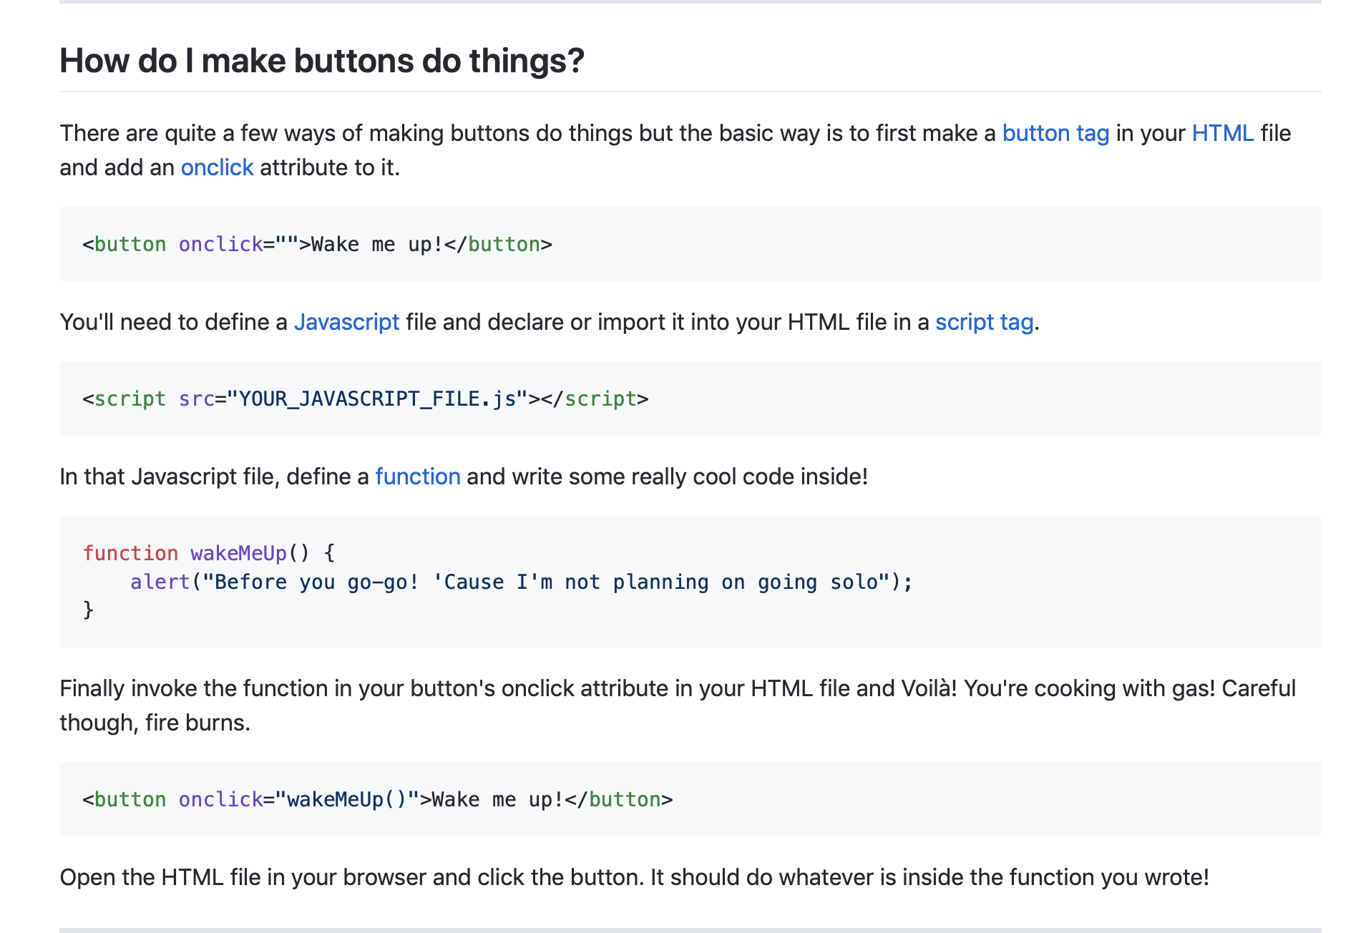
Frontend – Actionable buttons (Web/Mobile Web)

Slide 45
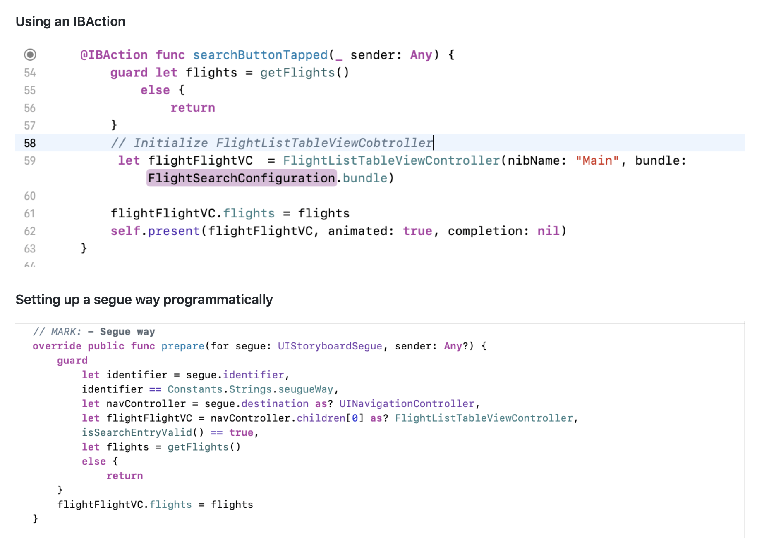
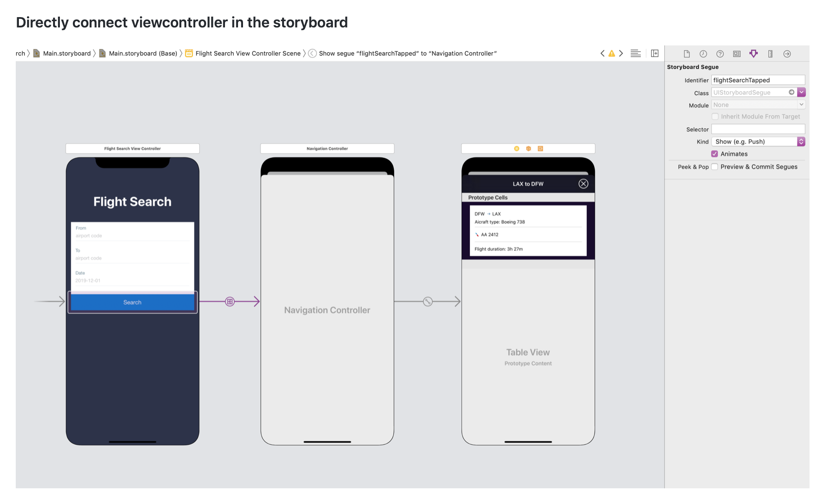
Frontend – Actionable buttons (iOS)
There are three different ways to accomplish this:
Directly connecting your button to the view controller you want to present
Using an IBAction.
Creating a segue way with a unique identifier

Slide 46
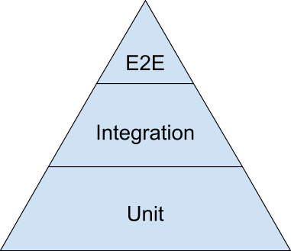
Testing the Applications

Slide 47
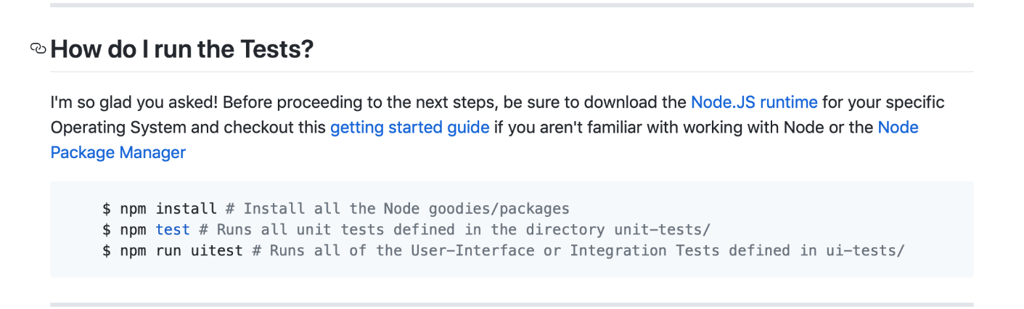
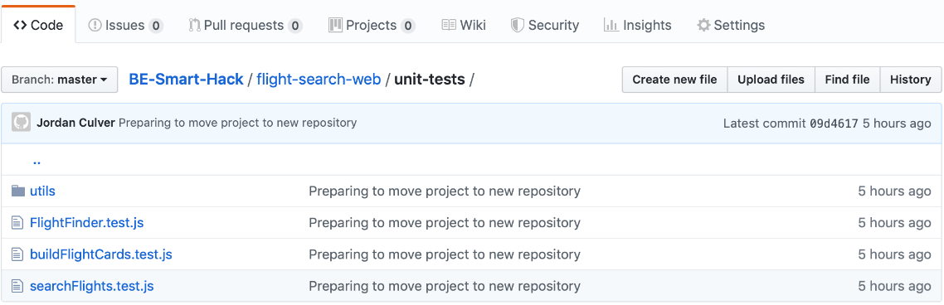
Testing the Applications

Slide 48
BE Smart Hackathon
Partners

Slide 49


Slide 50
Enabling Partners: Github
GitHub is where software development lives. Use GitHub to collaborate with your teams, keep track of and organize your work, and integrate with other tools to transform your ideas, first into code, and then into applications!

Slide 51


Slide 52
Teradata
Teradata Vantage 16.20
Massively parallel database for analytics
Teradata Query Service
API application interface to Teradata Vantage environment
teradataml and tdplyr
Python and R library interface into Teradata Vantage environment
Sample Airline Data Set

Slide 53









Teradata
Applications
tdplyr
Teradata Query Service
teradataml
Teradata Vantage
Sample Airline Data
Load your own data

Slide 54

Prizes
Bose QuietComfort 35 II Wireless Bluetooth Headphones, Noise-Cancelling, with Alexa voice control, enabled with Bose AR – Black

Slide 55


Slide 56







Technology Hack Options
User authentication
User Authentication enables single sign-on for your mobile app, so users can effortlessly authenticate with any cloud and on-premises app.
App Service supports five identity providers out of the box, including: Azure Active Directory, Facebook, Google, Microsoft Account, and Twitter, as well as your own custom identity solution.
Learn more
Storage and data connections
Azure Storage is massively scalable, and accessible from anywhere and from any device. Whether it’s images, photos, documents, or customer records—in the cloud or on premises—Azure makes it simple to create or integrate the right kind of storage.
Learn more
Push notifications
Notification Hubs let your apps broadcast personalized push notifications to millions of users in minutes. Send breaking news, enterprise-wide announcements, and location-based coupons—no heavy-lifting required.
Learn more
Cognitive services
Surprise and delight your users with intelligent, interactive apps. Access next-generation cloud services in Azure that can take your apps even further with features like facial recognition, intelligent bots, visual search, and other kinds of exciting advanced functionality.
Learn more
Shopping Demo App sample application
The Shopping Demo App is a consumer-facing sample app for Android, iOS, and UWP and includes a wide range of Azure services. Explore the code to see how you can: quickly add authentication, allow users to buy and sell items, send and receive push notifications for account updates, and tap into emotion recognition to rate the app with a smile.
Get the code | Documentation | Deploy to your subscription
Offline sync
Use offline data sync to make sure your users can view, create, and modify data, even when they experience connectivity issues or are offline.
Learn more

Slide 57

Prizes
Cool Backpack filled with swag, an Office 365 subscription and Headphones.
(Value: $350)

Slide 58


Slide 59







Accept payments from any card.
Our feature-rich secure platform makes it easy to build payments into an app or website.
Integrate with Apple Pay and Android Pay
Accept payments in websites, in-apps, in chatbots, in Alexa and NLP skills
Offer subscriptions with simple recurring payments
Store customer's payment information securely to simplify future purchases
Send eInvoices electronically and get paid securely
Accept all major brands of domestic and international credit, debit and pre-paid cards

Slide 60


Send
Deliver payments to a person's checking account in seconds using any debit card from any network.
Google Pay allows users to quickly cash out money from their wallet balance using their debit card, rather than waiting for days
Uber drivers can request a payment for past rides at any time and get access to the funds in seconds
Bershire Hathaway and Allstate insurances transfer funds in real time, as soon as damages are confirmed, e.g. a plane is delayed for a travel insurance
Compensate passengers for any issue in real time, and reward preferred customers

Slide 61



Merchant Data: Places
Places API allows you to access rich, analytics-driven merchant location information to help understand popularity, seasonality, and other trends of storefronts with Places.
Places can help answer questions like:
Is this restaurant a local favorite?
Is this store a hidden gem?
Is this location currently in business?
Key features include:
Finding merchant locations based on latitude and longitude
Identifying merchants that are popular with the locals, but not amongst tourists
Determining if a merchant is still in business based on recent transaction history NOTE: In order to utilize the radius search functionality in the Merchant Point of Interest resource you must provide a Latitude and Longitude.

Slide 62
Prizes
It pays to use Mastercard! We offer our winning team a SPECIAL prize of $250 per team member!

Slide 63


Slide 64





Software intelligence built for the enterprise cloud
Go beyond APM with the Dynatrace all-in-one platform
Application performance monitoring
Cloud infrastructure monitoring
AIOps
Digital experience management
Software Intelligence Platform
Notes:
Dynatrace is the only solution built with software intelligence specifically designed for the new enterprise cloud.
We saw this major enterprise cloud disruption coming back in 2012…
To seize the opportunity, we made the decision to reinvent our platform from the ground up…
To purpose build for the hybrid cloud, microservices, webscale and so on…
We brought it to market in 2014, scaled it to the enterprise in 2016, and now it’s everywhere.
It’s the only next gen approach on the market.
Let’s take a closer look…

Slide 65

Dynatrace - Software intelligence built for the enterprise cloud
Application performance management
Microservices & containers
Lifecycle analytics
Code-level
Transaction tracing
Database monitoring
Monolith and mainframe
Cloud infrastructure monitoring
Cloud monitoring
Container monitoring
Virtualization monitoring
Server monitoring
Network monitoring
Log monitoring
AIOps
Continuous auto-discovery
Automatic topology
Anomaly detection
Root cause analysis
Prediction
Third party data & metrics
Digital experience management
Real user monitoring
Session replay
Mobile app monitoring
Synthetic monitoring
RUM for SaaS vendors
Digital experience insights
All-in-one software intelligence platform.
Notes:
In summary, Dynatrace’s all-in-one software intelligence platform is the only solution purpose-built for the challenges of the new enterprise cloud.

Slide 66





Better data makes Dynatrace A.I. (Davis) and massive automation possible
High fidelity data
Mapped end-to-end
Deterministic AI
Answers + Action
Users
Apps
Services
Code
Server
Logs
Network
Custom
Automated problem detection
OneAgent
Business impact determined
Root cause explained
No alert storms
Trigger self healing
Completely automated
Notes:
Let’s dig into artificial intelligence more deeply so that we don’t confuse the buzz word with what Dynatrace actually delivers today as A.I. is an important pillar to how Dynatrace works.
It begins with the input data. The Dynatrace OneAgent makes it super easy to capture high fidelity data across your full stack of technology.
The next key is that the data is connected using PurePath and SmartScape. PurePath is the end to end transaction capture and SmartScape is the real-time map of your entire enterprise.
Because of this rich and connected data set, now we can leverage A.I. algorithms to perform the automation such as:
Detecting problems automatically (no configuration required)
Determine the business impact of problems automatically
Determine the root cause of problems automatically
And more
This is all made possible because of rich, connected data that Dynatrace captures.
This process is completely automated and requires no manual effort to setup.

Slide 67



Prizes
Bose SoundSport Free Wireless Headphones
Notes:
Dynatrace is the only solution built with software intelligence specifically designed for the new enterprise cloud.
We saw this major enterprise cloud disruption coming back in 2012…
To seize the opportunity, we made the decision to reinvent our platform from the ground up…
To purpose build for the hybrid cloud, microservices, webscale and so on…
We brought it to market in 2014, scaled it to the enterprise in 2016, and now it’s everywhere.
It’s the only next gen approach on the market.
Let’s take a closer look…

Slide 68


Slide 69
The Challenge
“Enhance the customer experience throughout their journey.”

Slide 70
American Airlines Prizes
1st Place | 2nd Place | 3rd Place
$1500 Scholarship For Spring Semester | $1250 Scholarship For Spring Semester | $1000 Scholarship For Spring Semester
100,000 AA Advantage Miles | 75,000 AA Advantage Miles | 50,000 AA Advantage Miles
AA Branded Computer Backpack | AA Branded Computer Backpack | AA Branded Computer Backpack
AA Branded Headphones | AA Branded Headphones | AA Branded Headphones

Slide 71
Repo Link
https://github.com/AmericanAirlines/Flight-Engine/wiki/BE-Smart-2019

